Slide 1

Knowledge graphs
CS 7340
IIT JODHPUR
TAUGHT BY LIPIKA DEY, TCS RESEARCH

Slide 2
Semantic Web
Semantic Web is a vision of Tim Berners-Lee as an extension of the World Wide Web,
Software programs with machine-interpretable metadata of the published information and data
Add further data descriptors to otherwise existing content and data on the Web
Computers should be able to use these descriptors to make meaningful interpretations similar to the way humans process information to achieve their goals
“Web” - conveys the idea of a navigable space of interconnected objects with mappings from URIs to resources
Linked Open Data +Semantic Metadata

Slide 3
Linked Data
Linked Data is a set of design principles for sharing machine-readable interlinked data on the Web
Helps in linking huge datasets coming from disparate sources and link them to Open Data
Boosts knowledge discovery and efficient data-driven analytics
Linked data may contain
Factual data about specific entities and concepts (e.g., Varna, WW2 or the Global warming theory);
Ontologies – semantic schemata defining:
Classes of objects (e.g., Person, Organization, Location and Document);
Relationship types (e.g., a parent of or a manufacturer of);
Attributes (e.g., the DoB of a person or the population of a geographic region).

Slide 4
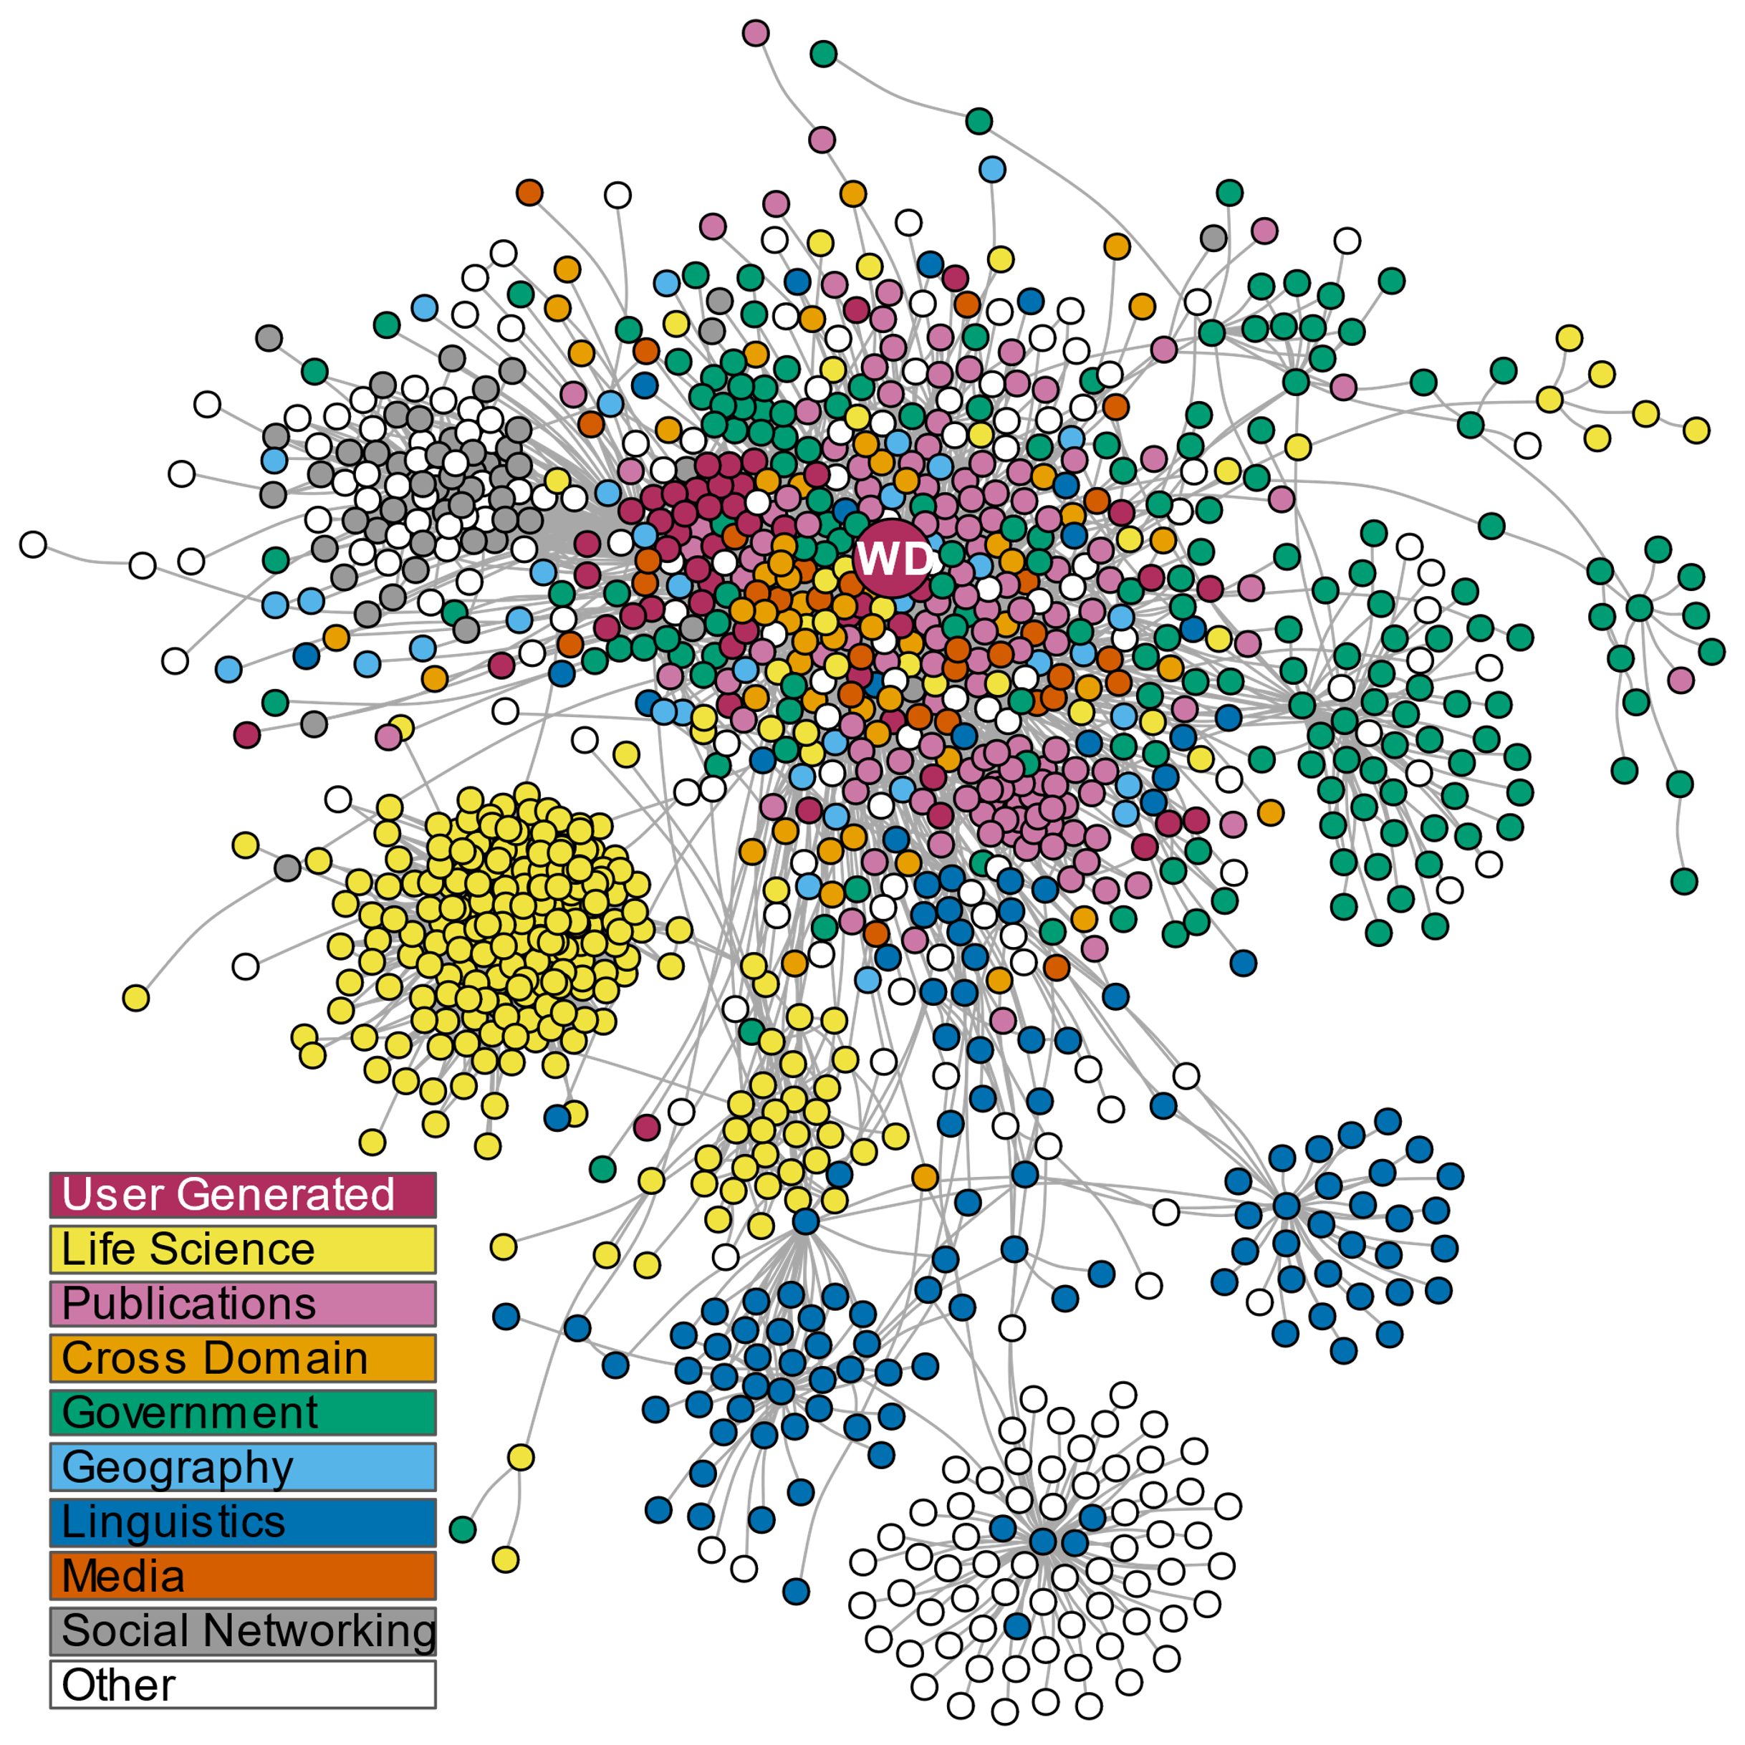
Linked Open Data
.
Linked data - structured interlinked data
Useful for handling semantic queries
Builds upon standard Web technologies such as HTTP, RDF, URIs – usually used to create pages for easy human interpretation
Linked Open Data Extends them to share information in a way that can be read automatically by computers
Objective of linked data – Internet to become a global database

Slide 5
Principles of Linked Data
All conceptual things should have a name starting with HTTP.
Looking up an HTTP name should return useful data about the thing in question in a standard format
Anything else that that same thing has a relationship with through its data should also be given a name beginning with HTTP

Slide 6
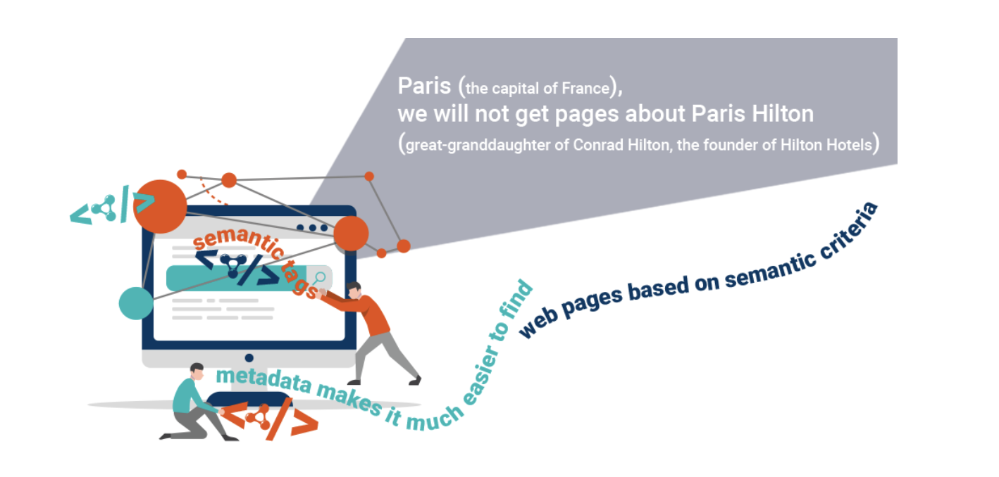
Semantic Metadata: Tagging the Existing Web
Semantic metadata - semantic tags that are added to regular Web pages in order to better describe their meaning
Well-determined relationships between the subject of the
Web page and the corresponding page or document,
Use one of the structured data metadata schemes
Most popular scheme - Schema.org
, which was established by Google, Yahoo, Microsoft and Yandex.
Around 30% of Web pages contain Semantic Metadata.

Slide 7
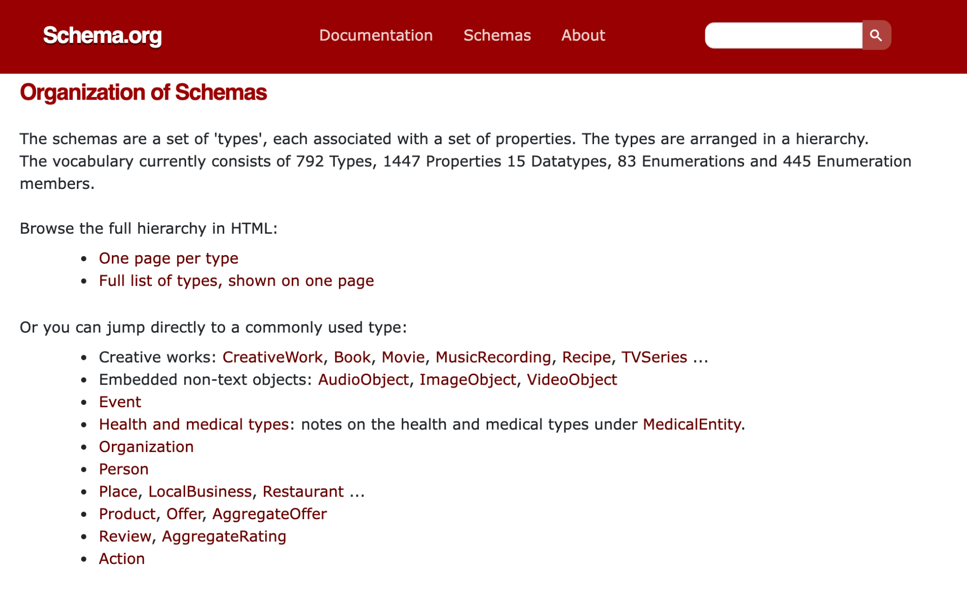
Schema.Org

Slide 8
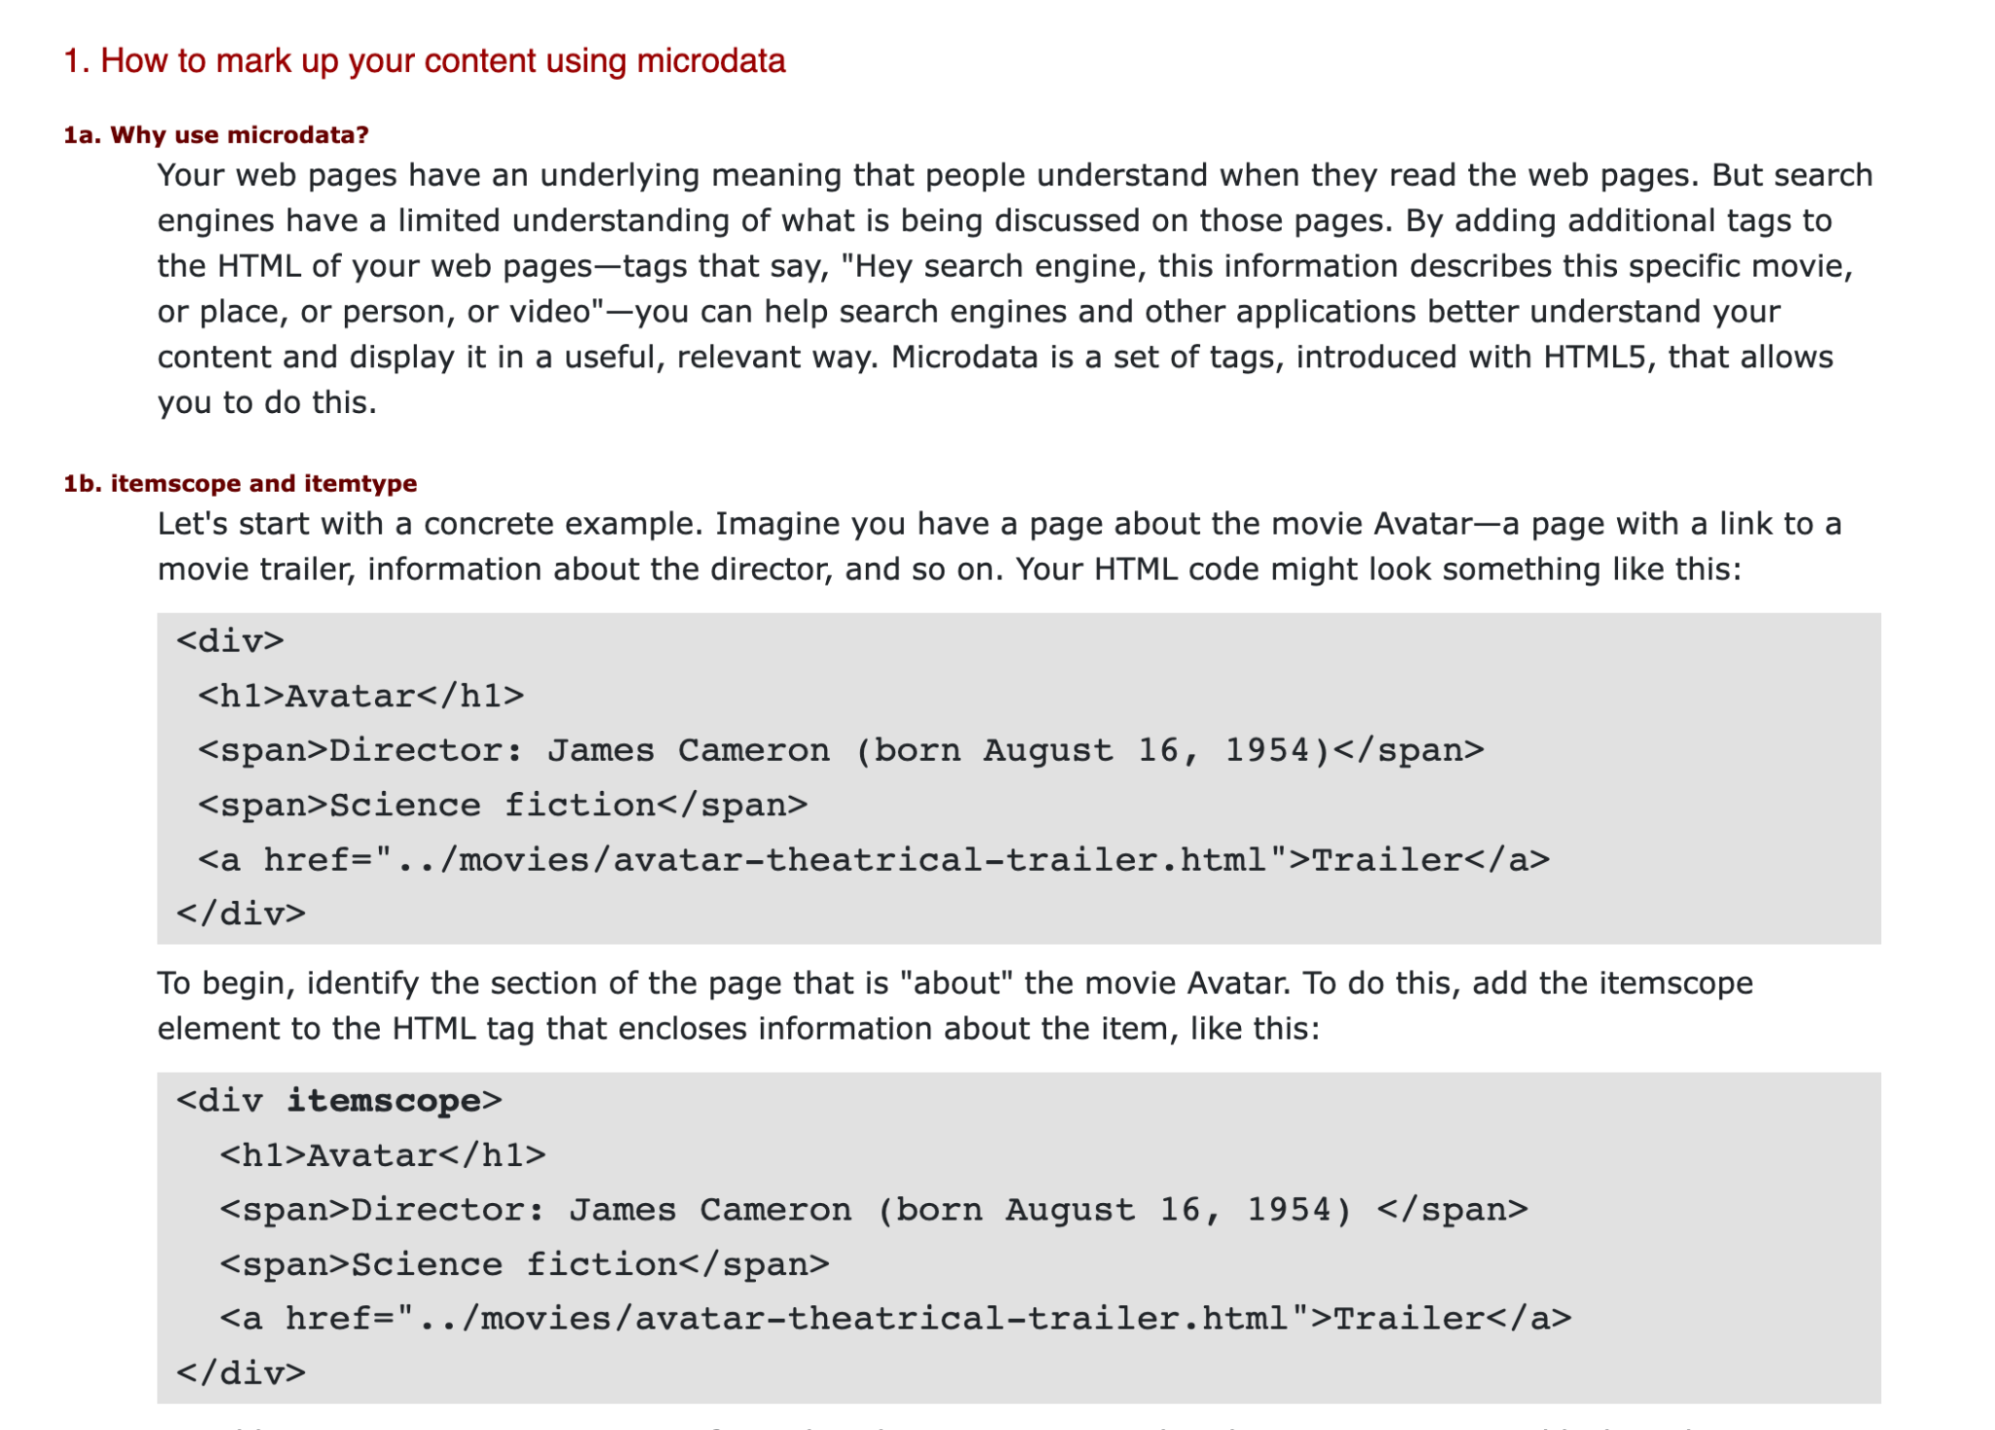
Content tagging

Slide 9
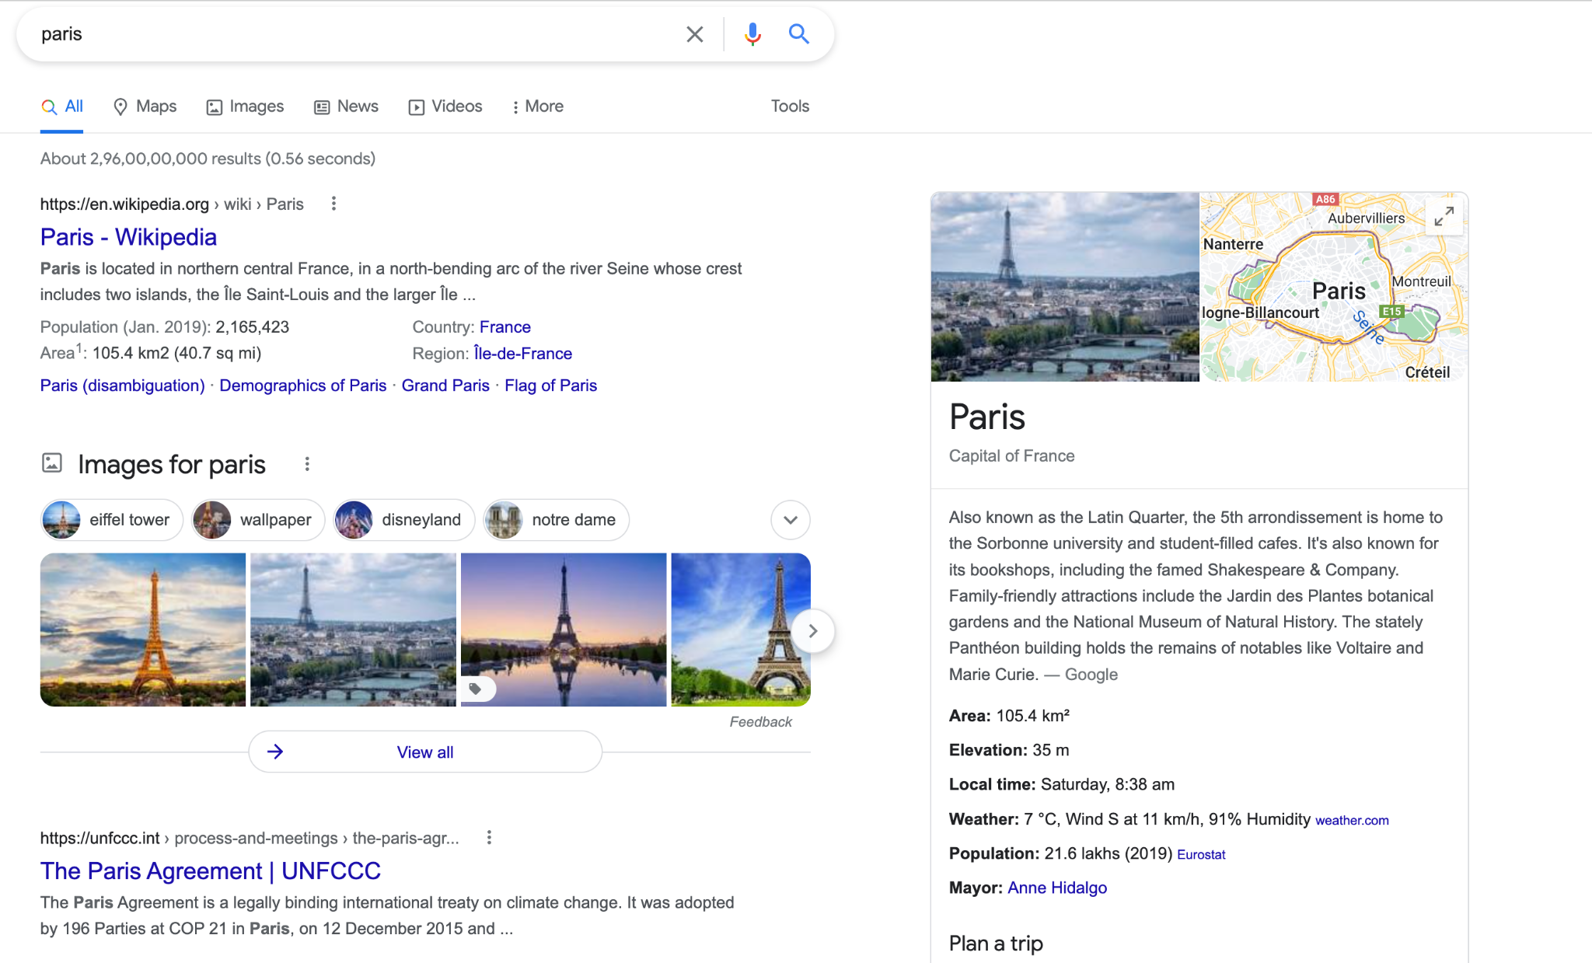
Who uses it?

Slide 10
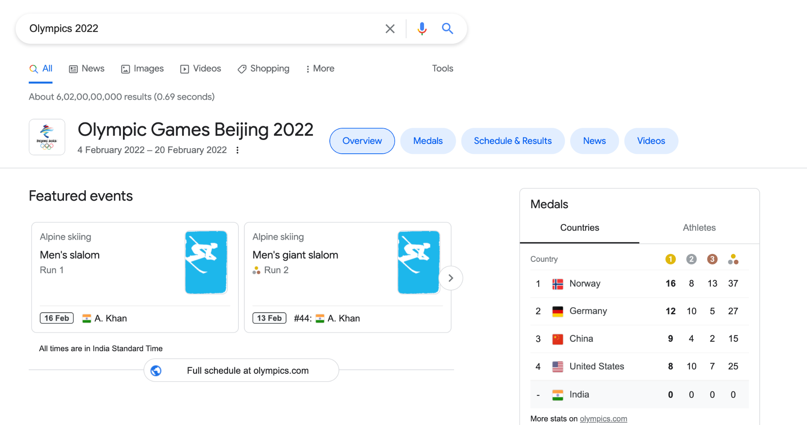
Events

Slide 11
5-star linked open data
1 star: data is openly available in any format.
2 stars: data is available in a structured format, such as Microsoft Excel file format (.xls).
3 stars: data is available in a non-proprietary structured format, such as Comma-separated values (.csv).
4 stars: data follows W3C standards, like using RDF and employing URIs.
5 stars: all of the other, plus links to other Linked Open Data sources.

Slide 12
Building Knowledge Graphs
A knowledge graph is a graph structured Knowledge Base used to store interlinked descriptions of entities
Entity
Person (DOB, POB, PRIMARY EDUCATION, SECONDARY EDUCATION, HIGHER EDUCATION, JOB ROLES, PUBLICATIONS)
Event (Type, Actors, Location, Date, Action)
Disease (Name, Symptoms, Medicine, Gene responsible)

Slide 13
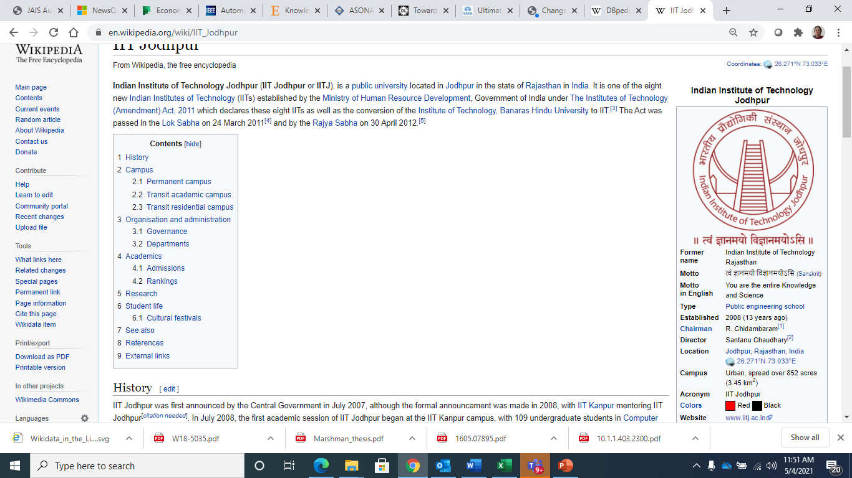
Datasets that serve as useful Knowledge Graphs
1. DBpedia – a database containing extracted data from Wikipedia in the form of 3.4 million concepts described by 1 billion triples, including abstracts in 11 different languages
Created from "infobox" tables of Wikipedia
Categorization information
Images
Geo-coordinates
Links to external Web pages
1.5M persons, 810k places, 135k music albums, 106k films, 20k video games, 275k organizations, 301k species and 5k diseases

Slide 14
Resource Description Framework
RDF is a framework for expressing information about resources
Resources can be anything, including documents, people, physical objects, and abstract concepts
RDF was intended to enable publishing and interlinking data on the Web
Example - http://www.example.org/bob#me – a page about Bob
Retrieving this page will provide information about Bob and also contain information that Bob knows Alice identified by her International resource Identifier (IRI)
Retrieving Alice's IRI could then provide more data about her - including links to other datasets for her friends, interests, etc.

Slide 15
Other Useful Knowledgebases
BabelNet – multilingual encyclopedic dictionary stored as a semantic network created using WordNet
Integration is done using an automatic mapping and by filling in lexical gaps in resource-poor languages using statistical machine translation
Provides concepts, named entities in many languages and connected with large amounts of semantic relations

Slide 16
Cyc
The Cyc knowledge base of general common-sense rules and assertions involving those ontological terms was largely created by hand axiom-writing
Has around 24.5 million relations and has taken well over 1,000 person-years of effort to construct.
416,000 collections (types, sorts, natural kinds, which includes both types of things such as Fish and types of actions such as Fishing)
A little over a million individuals representing
42,500 predicates (relations, attributes, fields, properties, functions),
About a million generally well known entities such as TheUnitedStatesOfAmerica, BarackObama, TheSigningOfTheUSDeclarationOfIndependence, etc.

Slide 17
Others
GeoNames – provides RDF descriptions of more than 7,500,000 geographical features worldwide
Wikidata – a collaboratively-created linked dataset that acts as central storage for the structured data of Wikimedia
Global Research Identifier Database (GRID) – an international database of 89,506 institutions engaged in academic research, with 14,401 relationships
Two types of relationships:
a parent-child relationship that defines a subordinate association
a related relationship that describes other associations

Slide 18
Knowledge Graph Elements
Book
BookSeries
EducationalOrganization
Event
GovernmentOrganization
LocalBusiness
Movie
MovieSeries
MusicAlbum
MusicGroup
MusicRecording
Organization
Periodical
Person
Place
SportsTeam
TVEpisode
TVSeries
VideoGame
VideoGameSeries
WebSite

Slide 19
RDF Triples
RDF statement expresses a relationship between two resources and is made in the form of Triples
<subject> <predicate> <object>
The subject and the object represent the two resources being related;
The predicate represents the nature of their relationship
The relationship is phrased in a directional way (from subject to object) and is called in RDF a property

Slide 20
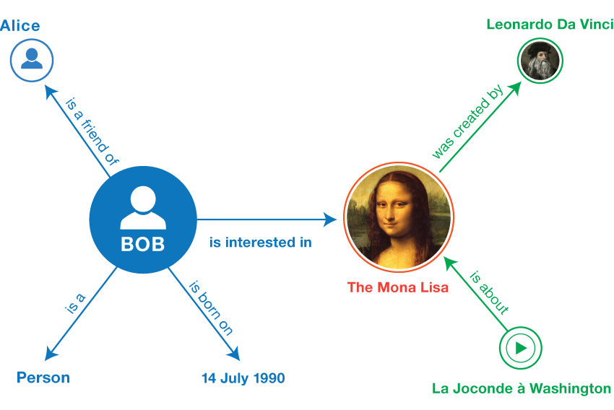
RDF Triples and Linked Data
<Bob> <is a> <person>.
<Bob> <is a friend of> <Alice>.
<Bob> <is born on> <the 4th of July 1990>.
<Bob> <is interested in> <the Mona Lisa>.
<the Mona Lisa> <was created by> <Leonardo da Vinci>.
<the video 'La Joconde à Washington'> <is about> <the Mona Lisa>

Slide 21
RDF Schema constructs
Construct | Syntactic form | Description
Class (a class) | C rdf:type rdfs:Class | C (a resource) is an RDF class
Property (a class) | P rdf:type rdf:Property | P (a resource) is an RDF property
type (a property) | I rdf:type C | I (a resource) is an instance of C (a class)
subClassOf (a property) | C1 rdfs:subClassOf C2 | C1 (a class) is a subclass of C2 (a class)
subPropertyOf (a property) | P1 rdfs:subPropertyOf P2 | P1 (a property) is a sub-property of P2 (a property)
domain (a property) | P rdfs:domain C | domain of P (a property) is C (a class)
range (a property) | P rdfs:range C | range of P (a property) is C (a class)

Slide 22
Defining properties
Properties are themselves resources that can be described by triples or provide values in the descriptions of other resources
"Friend of a Friend" (FOAF) - vocabulary for describing social networks
Dublin Core
Maintains a metadata element set for describing a wide range of resources - provides properties such as "creator", "publisher" and "title".
schema.org
Schema.org is developed by a group of major search providers
Webmasters can use these terms to mark-up Web pages for search engines to understand what the pages are about.

Slide 23
Writing RDF graphs
Different serialization formats exist for writing down RDF graphs
Different ways of writing down the same graph lead to exactly the same triples and are thus logically equivalent.
Turtle family of RDF languages (N-Triples, Turtle, TriG and N-Quads);
JSON-LD (JSON-based RDF syntax);
RDFa (for HTML and XML embedding);
RDF/XML (XML syntax for RDF).

Slide 24
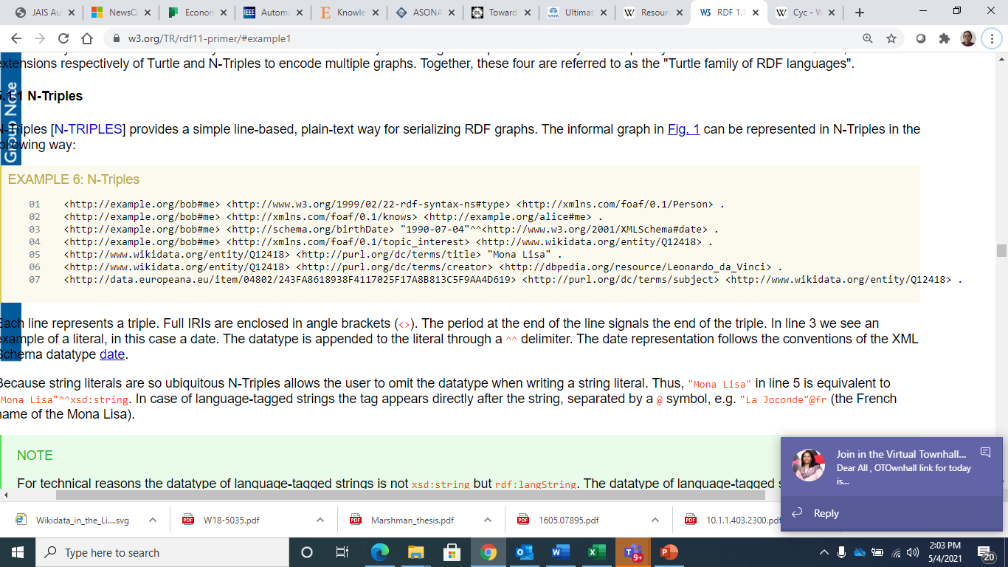
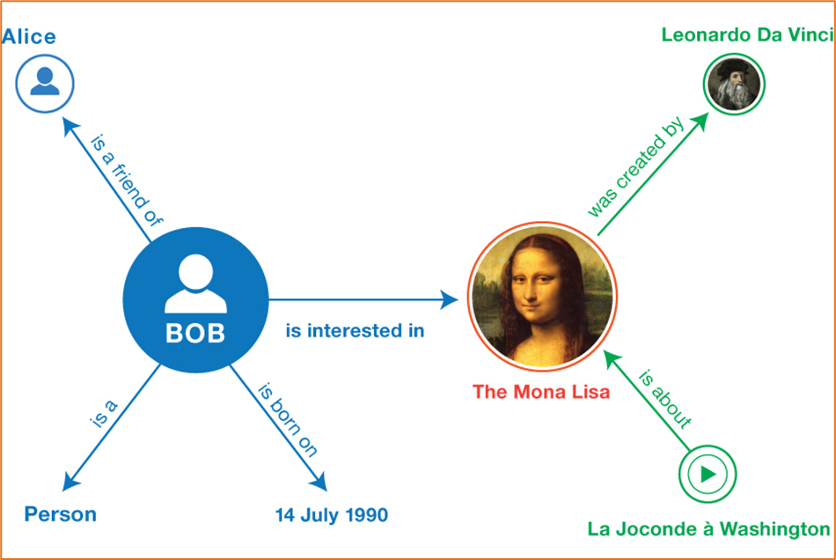
N-triple Formal description
Multiple schemas have been used

Slide 25
JSON
JSON-LD [JSON-LD] provides a JSON syntax for RDF graphs and datasets
JSON-LD can be used to transform JSON documents to RDF with minimal changes
JSON-LD offers universal identifiers for JSON objects, a mechanism in which a JSON document can refer to an object described in another JSON document elsewhere on the Web, as well as datatype and language handling
JSON-LD also provides a way to serialize RDF datasets through the use of the @graph keyword.

Slide 26
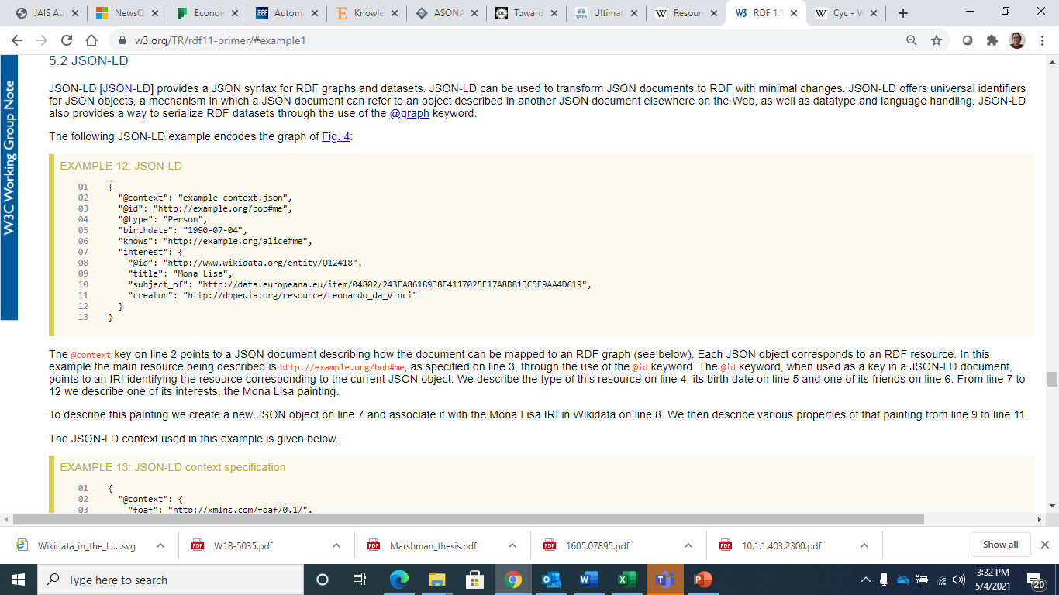
JSON - LD

Slide 27
More languages
https://www.w3.org/TR/rdf11-primer/#example1

Slide 28
Knowledge Graph Query
Knowledge Graphs can be queried using SPARQL
RDF query language
semantic query language for databases—able to retrieve and manipulate data stored in Resource Description Framework (RDF) format
One of the key technologies of the semantic web
PREFIX foaf: <http://xmlns.com/foaf/0.1/>
SELECT ?name
?email
WHERE
{
?person a foaf:Person .
?person foaf:name ?name .
?person foaf:mbox ?email .
}
Retrieve name and email of all

Slide 29
Uses of Knowledge Graph
A knowledge graph formally represents semantics by describing entities and their relationships
By doing this, they allow logical inference for retrieving implicit knowledge rather than only allowing queries requesting explicit knowledge
The Knowledge graphs may make use of ontologies as a schema layer

Slide 30
Basics of SPARQL
SELECT query
Used to extract raw values from a SPARQL endpoint, the results are returned in a table format.
CONSTRUCT query
Used to extract information from the SPARQL endpoint and transform the results into valid RDF.
ASK query
Used to provide a simple True/False result for a query on a SPARQL endpoint.
DESCRIBE query
Used to extract an RDF graph from the SPARQL endpoint, the content of which is left to the endpoint to decide, based on what the maintainer deems as useful information.
Each of these query forms takes a WHERE block to restrict the query

Slide 31
A slightly complex query
PREFIX ex: <http://example.com/exampleOntology#>
SELECT ?capital
?country
WHERE
{
?x ex:cityname ?capital ;
ex:isCapitalOf ?y .
?y ex:countryname ?country ;
ex:isInContinent ex:Africa .
}
SPARQL also supports aggregation, subqueries, negation, creating values by expressions, extensible value testing, and constraining queries by source RDF graph
The results of SPARQL queries can be result sets or RDF graphs.
https://www.w3.org/TR/2013/REC-sparql11-query-20130321/
Retrieve all the country names and their capitals of Africa

Slide 32
Ontology
An ontology encompasses a representation, formal naming and definition of the categories, properties and relations between the concepts, data and entities that substantiate one, many, or all domains of discourse
More simply, an ontology is a way of showing the properties of a subject area and how they are related, by defining a set of concepts and categories that represent the subject.
Every academic discipline or field creates ontologies to limit complexity and organize data into information and knowledge
Ontologies improve problem solving within that domain

Slide 33
Ontology Components
Individuals
Instances or objects (the basic or "ground level" objects)
Classes
Sets, collections, concepts, classes in programming, types of objects or kinds of things
Attributes
Aspects, properties, features, characteristics or parameters that objects (and classes) can have
Relations
Ways in which classes and individuals can be related to one another
Function terms
Complex structures formed from certain relations that can be used in place of an individual term in a statement
Restrictions
Formally stated descriptions of what must be true in order for some assertion to be accepted as input
Rules
Statements in the form of an if-then (antecedent-consequent) sentence that describe the logical inferences that can be drawn from an assertion in a particular form
Axioms
Assertions (including rules) in a logical form that together comprise the overall theory / prior knowledge that the ontology describes in its domain of application.
Events
The changing of attributes or relations

Slide 34
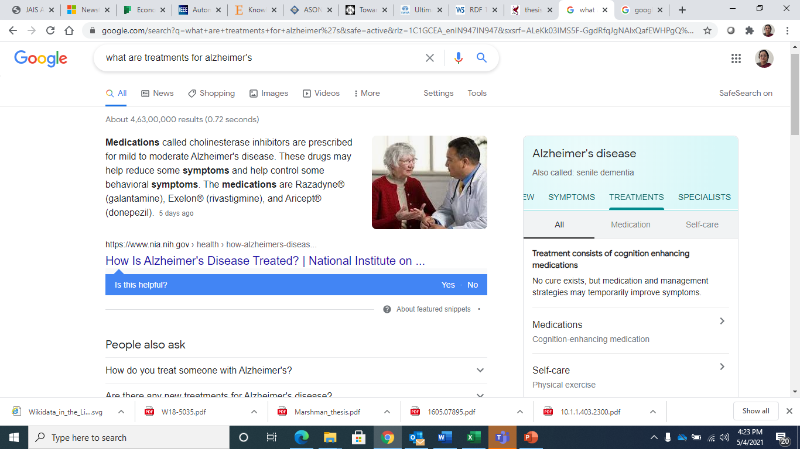
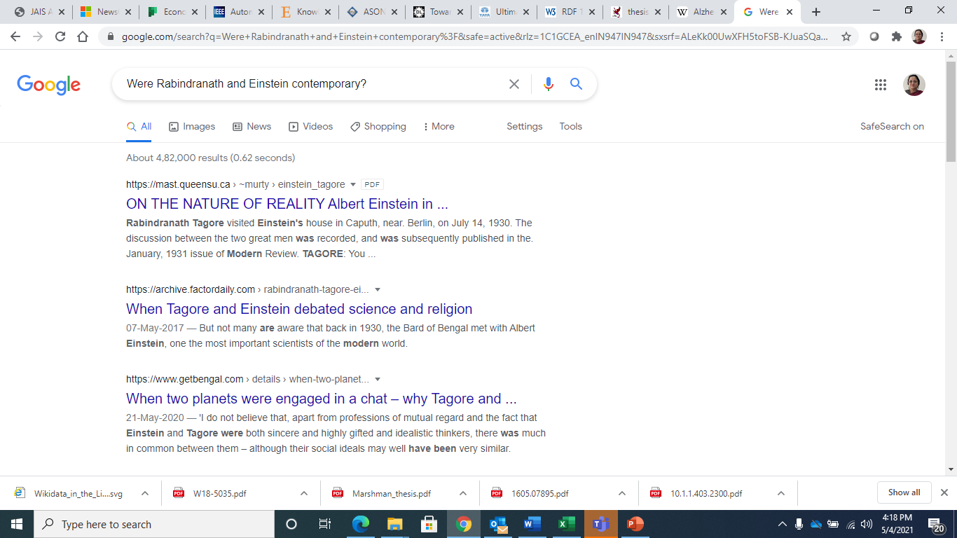
Utility of Knowledge Graphs
Were Rabindranath Tagore and Einstein contemporary? Did they every meet?
What are treatments for Alzheimer’s?
Google Knowledge Graph

Slide 35
Google Knowledge Graph
The Google Knowledge Graph is Google’s Knowledge Base
Enhances search engine results with information gathered from a variety of sources
The information is presented to users in an infobox next to the search results

Slide 36
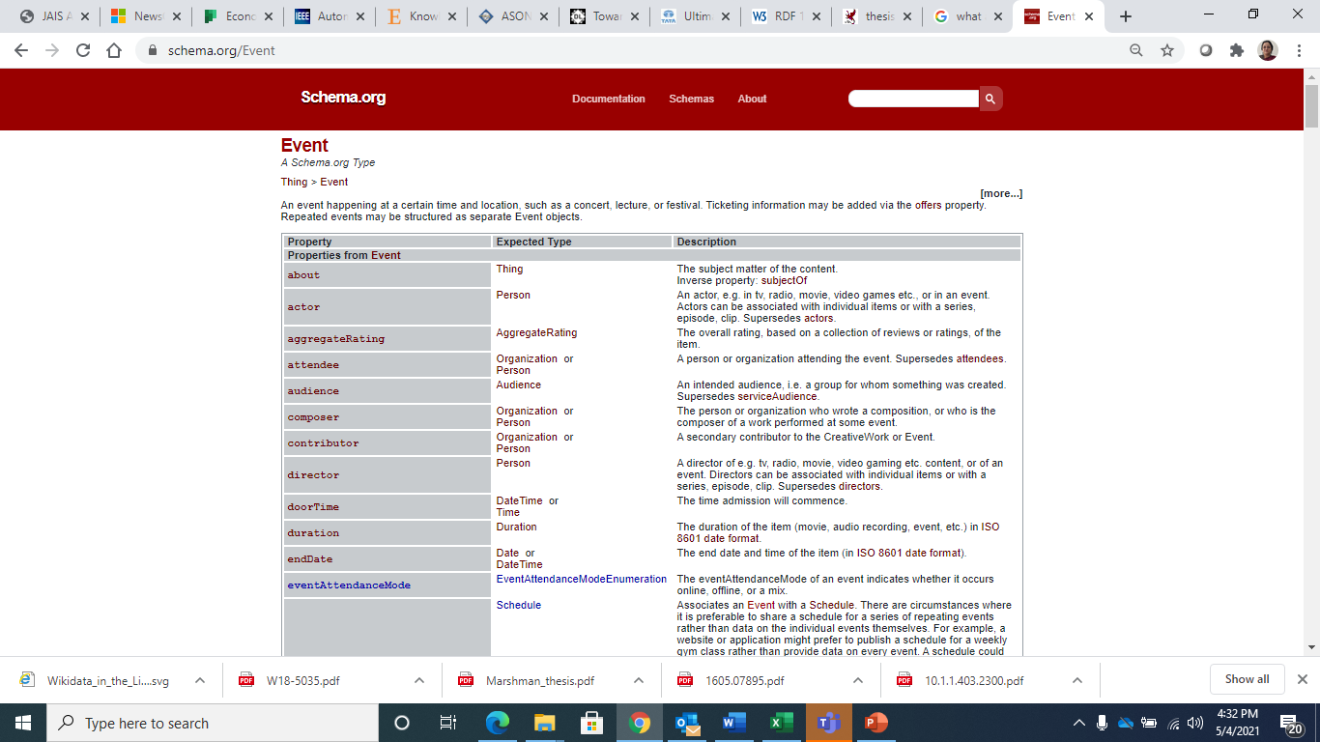

Slide 37
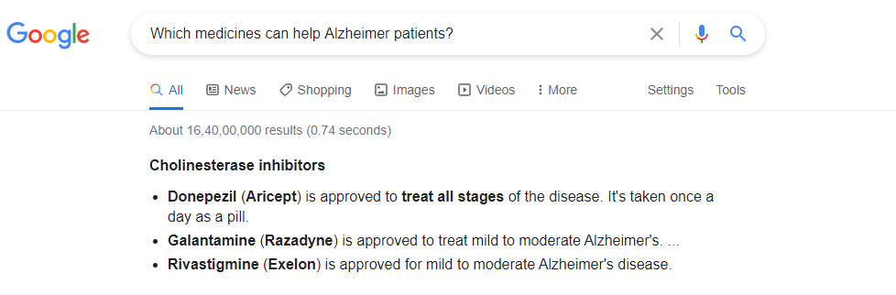
Ask in a different language
Which medicines can help Alzheimer patients?

Slide 38
NLP and Knowledge Graphs
Were Rabindranath Tagore and Einstein contemporary? Did they ever meet?
Can DbPedia help?

Slide 39
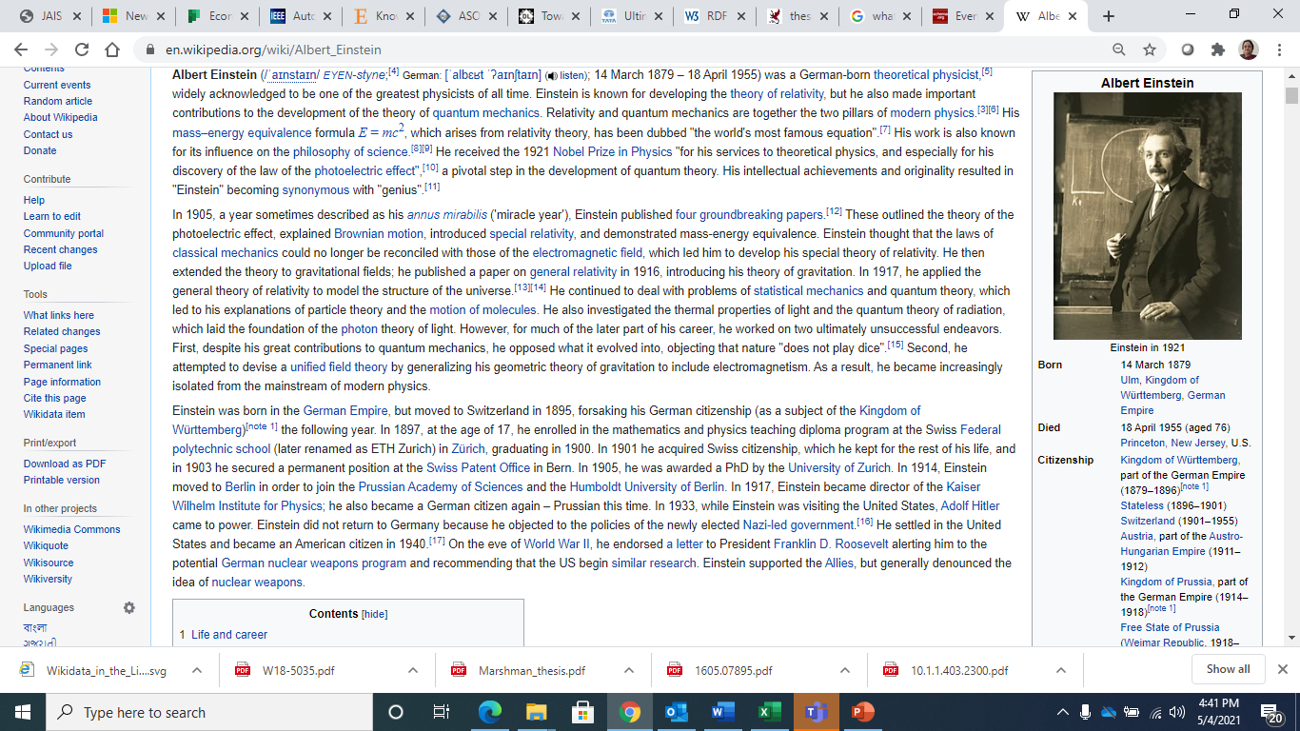
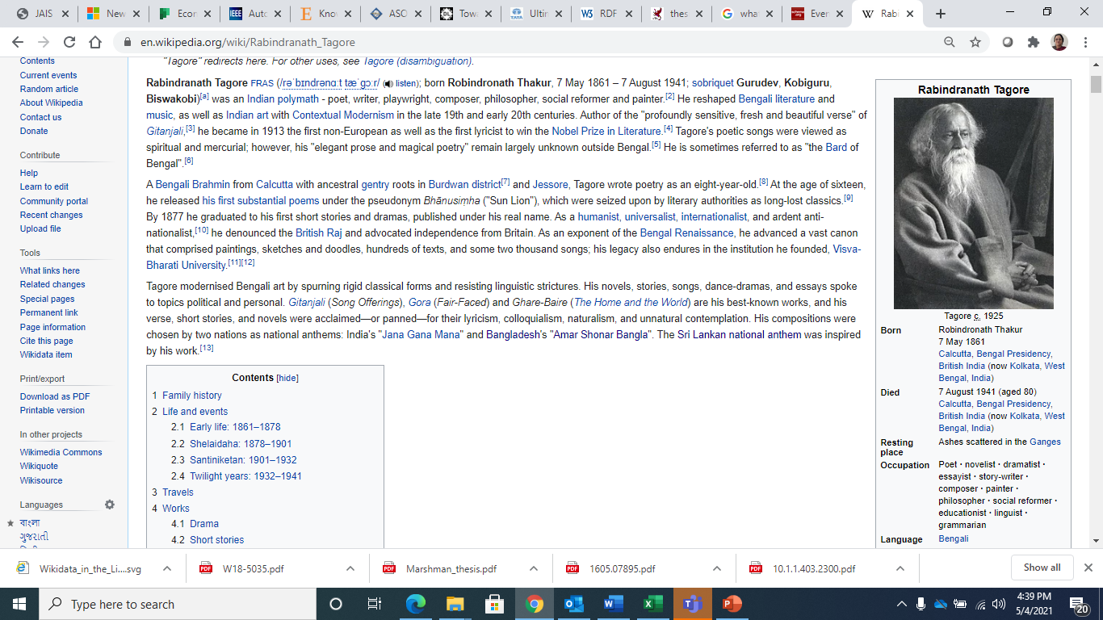
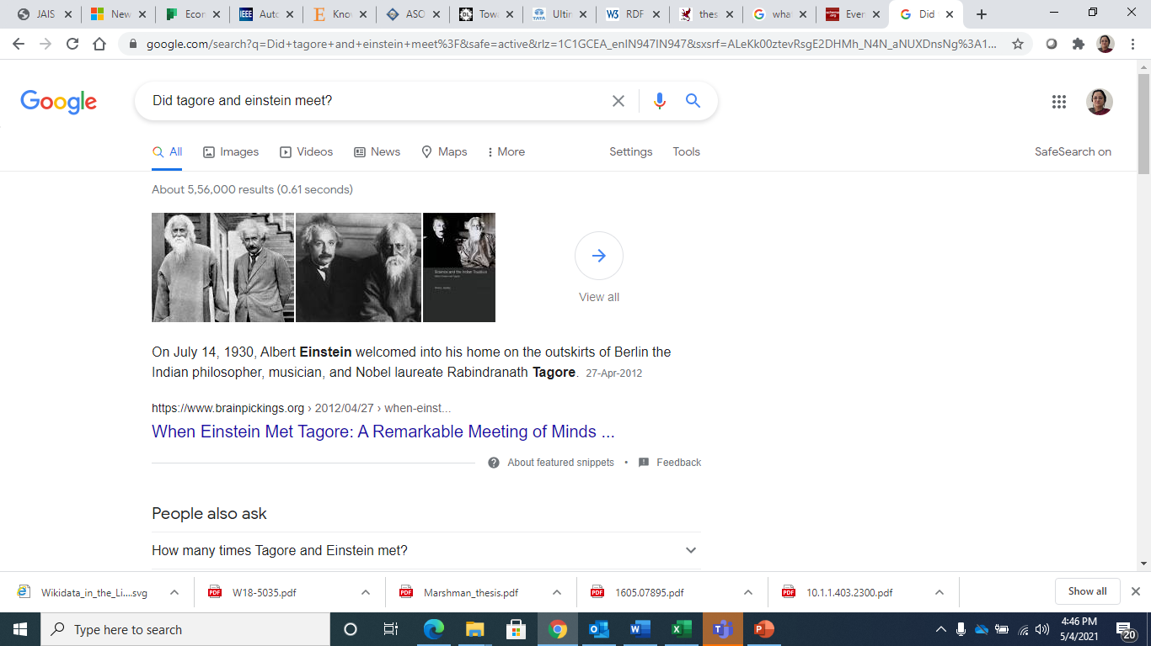
Living Period – 1861 - 1941
Living Period overlaps
Hence contemporary
Living Period – 1879 - 1955

Slide 40
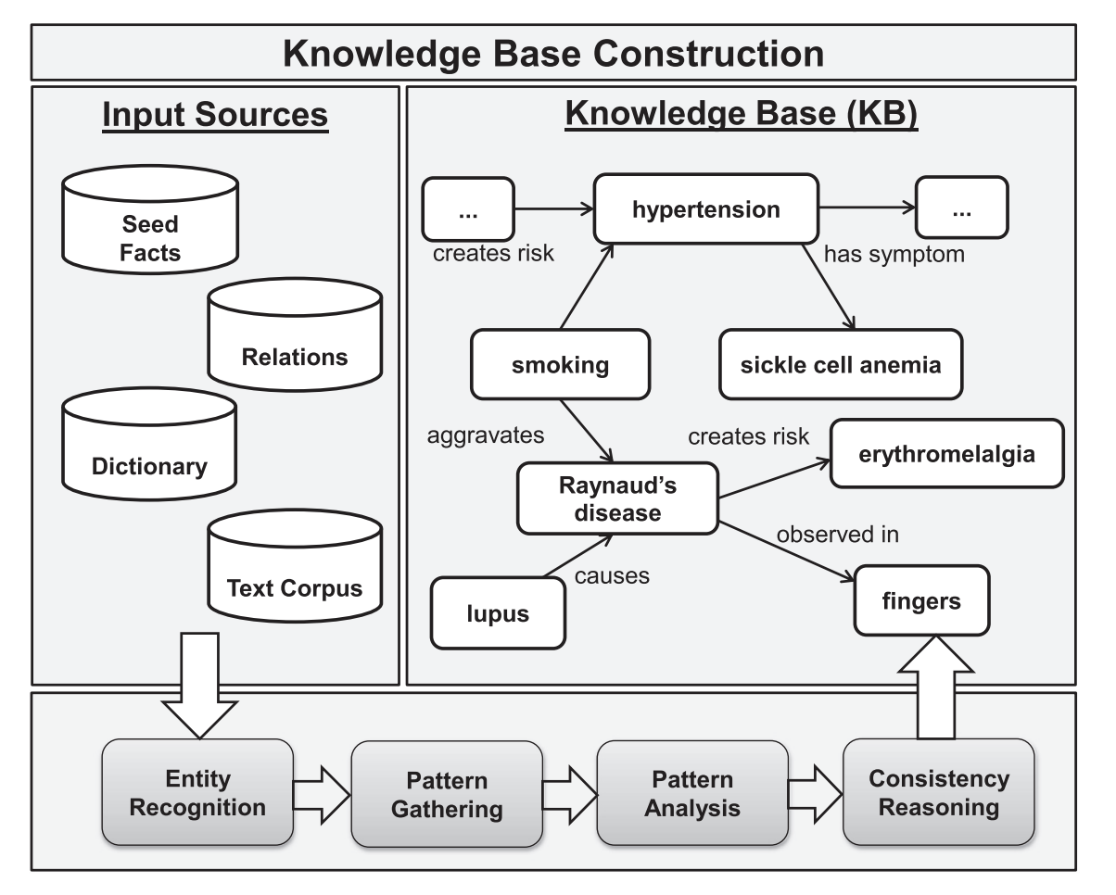
Biological KBs
Gene Ontology
Disease Ontology
National Drug File - Reference Terminology
Foundational Model of Anatomy

Slide 41
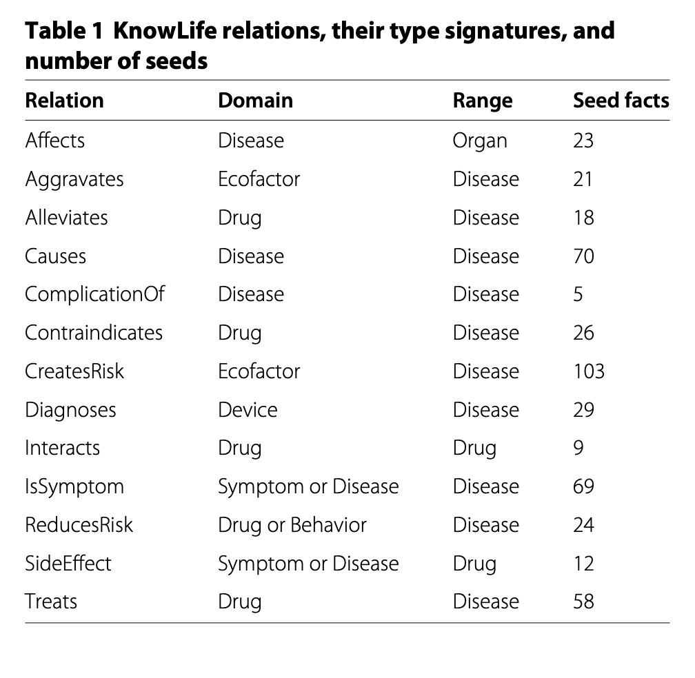
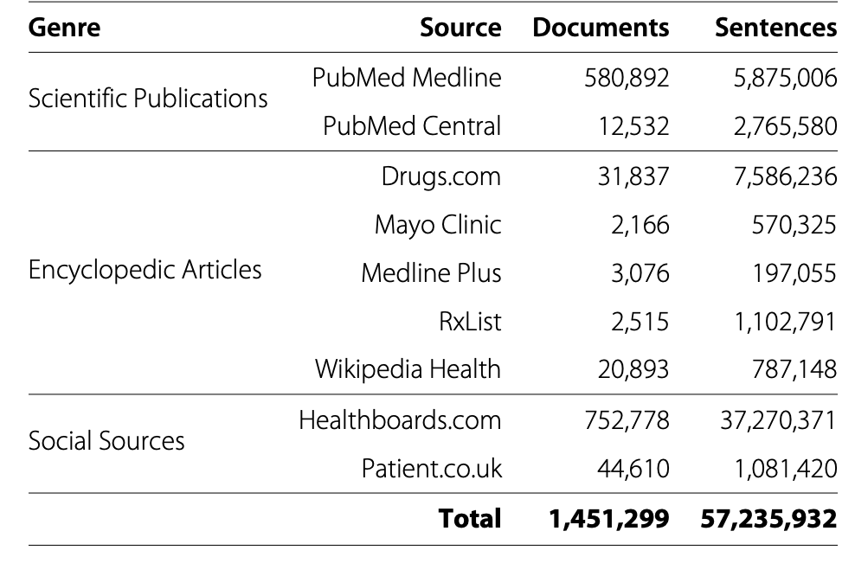

Slide 42
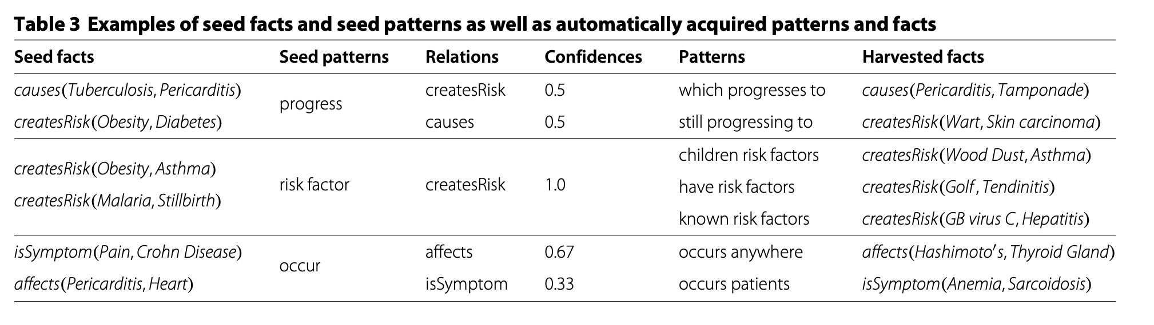

Slide 43
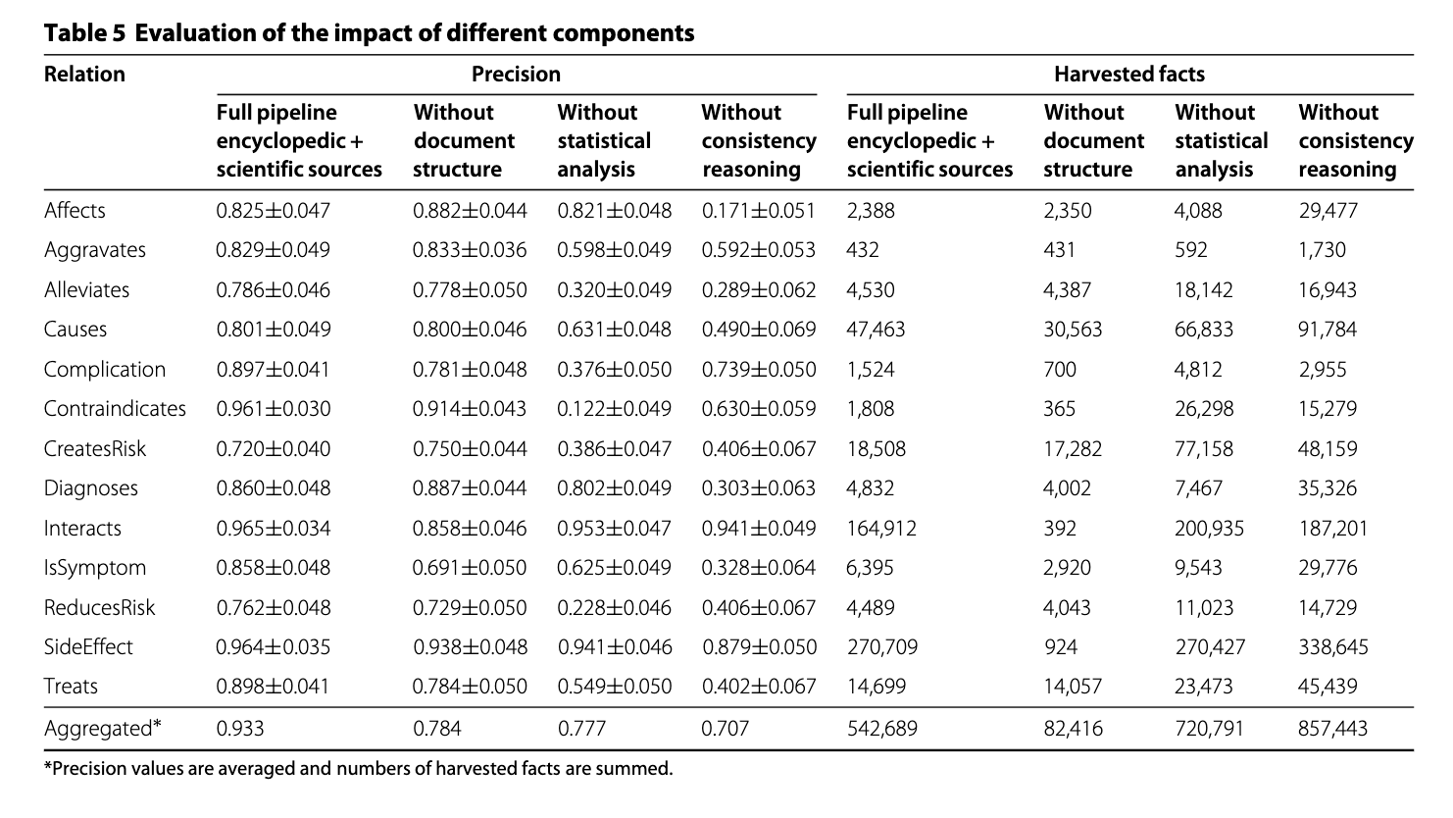

Slide 45
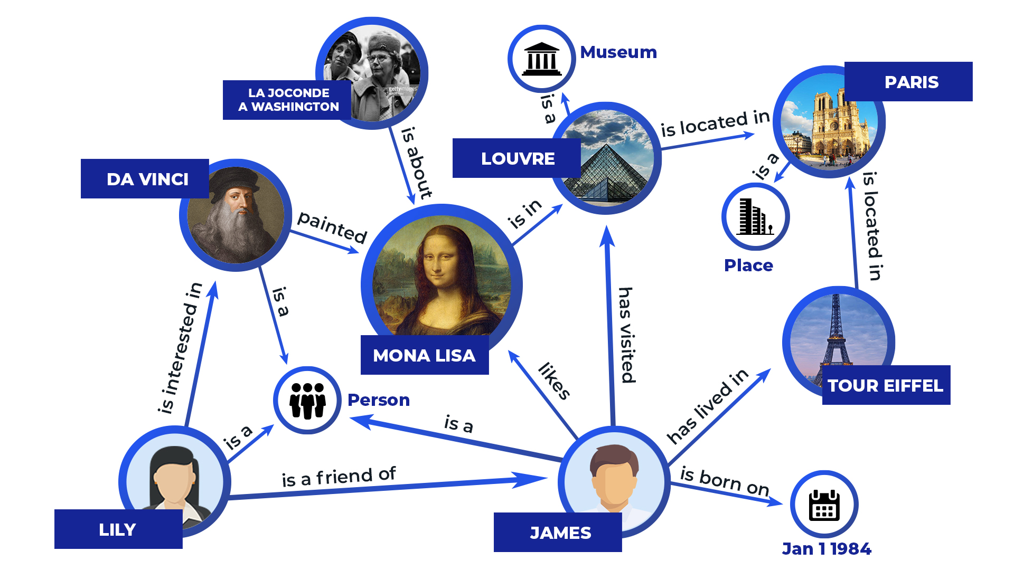
Knowledge Graphs
A knowledge graph is a graph-based data model that describes real-world entities and relations between them
Directed Edges represent relations - semantics of relations well-defined
Each Node can be a resource (Document with URL) or just an attributed node

Slide 46
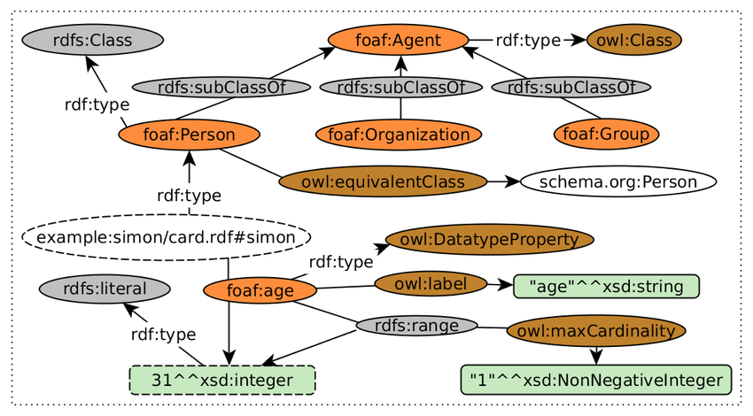
FOAF Ontology nodes and edges

Slide 47
FOAF Knowledge Base
@prefix rdf: <http://www.w3.org/1999/02/22-rdf-syntax-ns#> .
@prefix rdfs: <http://www.w3.org/2000/01/rdf-schema#> .
@prefix foaf: <http://xmlns.com/foaf/0.1/> .
<#JW>
a foaf:Person ;
foaf:name "James Wales" ;
foaf:mbox <mailto:jwales@bomis.com> ;
foaf:homepage <http://www.jameswales.com> ;
foaf:nick "Jimbo" ;
foaf:depiction <http://www.jameswales.com/aus_img_small.jpg> ;
foaf:interest <http://www.wikimedia.org> ;
foaf:knows [
a foaf:Person ;
foaf:name "Angela Beesley"
] .
<http://www.wikimedia.org>
rdfs:label "Wikimedia" .

Slide 48
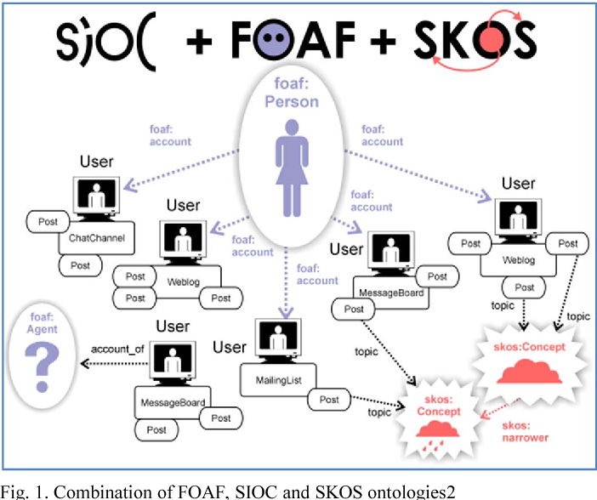
Extending Knowledge Graphs - Semantic Web
Semantically-Interlinked Online Communities
Simple Knowledge Organisation System

Slide 49
Question Answering using Knowledge graphs
Knowledge Graph Question Answering is a task that involves answering a natural language question using the information stored in a KG
“What are all the country capitals of Africa?” - different formulation - same query as earlier
“Who are the Delhi residents who love Jazz and Mughal architecture?”
“Who are all the jazz and Mughal architecture loving people of Delhi?”
NL Tasks :
Mapping of question elements to graph elements + formulation of Graph query

Slide 50
KGQA
PREFIX ex: <http://example.com/exampleOntology#>
SELECT ?capital
?country
WHERE
{
?x ex:cityname ?capital ;
ex:isCapitalOf ?y .
?y ex:countryname ?country ;
ex:isInContinent ex:Africa .
}
Semantic Parsing - Converting a natural question into a formal KG query
“What are all the country capitals in Africa?”

Slide 51
Neural Network based Semantic Parsers
Three types of parsers
Classification
Ranking
Translation based models
Input - NL Query
Output - Formal Graph Search Query

Slide 52
Classification based KGQA models
Works for Simple queries - comprise one subject entity, one relation and one object entity
“Where was Khan Abdul Ghaffar Khan born?”
A fixed simple structure of the output query is assumed that will involve two nodes and an edge
Khan Abdul Ghaffar Khan was born in Pashtun
<ex: Khan Abdul Ghaffar Khan, ex: bornIn, ex: Pashtun>
Graph query prediction task is broken down into two sub-tasks –
Relation prediction
Entity Prediction

Slide 53
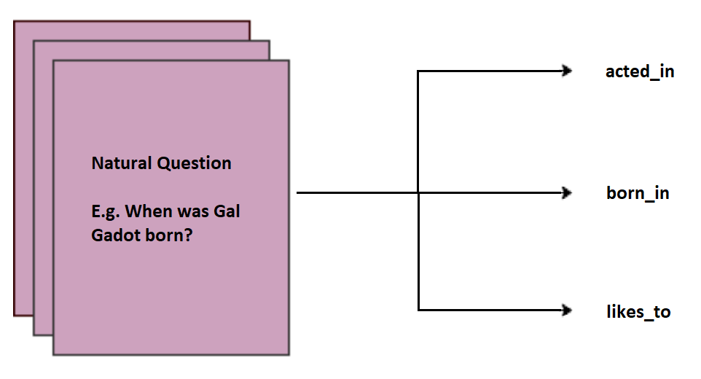
Relation Prediction
Given a natural question q, relation classification involves predicting one of the n relations of a given KG.
This can be treated as a standard text sequence classification problem where the natural question q is the input and one of the n relations is the output label
The input natural question is encoded into a fixed-length vector using LSTM, CNN, transformers etc.
The encoder output is fed into a densely connected network and finally a linear layer with N output nodes - where N is the number of relations in the KG
The label probabilities can be computed with a standard softmax
Relations in KG
Where was Khan Abdul Ghaffar Khan born?

Slide 54
Entity Prediction
A two-step method is employed for entity prediction –
An entity detector is employed to detect the entity form a natural question text.
“Where was Khan Abdul Ghaffar Khan born?” -> “Khan Abdul Ghaffar Khan”
Then, a simple text-based retrieval method is used to find suitable candidate(s) from the KG entities for the identified entity from the question

Slide 55
X(Person) has_account Y (Bank)
X (Bank) head_qtr Y(LOC)
X (Person) - sent_money - Y(Person)
Who are the people whom X sent money to? - KG query - cross-selling targets
Who bought what item? - eCommerce sites
X (Person) bought Y(product)
X (product) is_a Y(Category) - Dress category will have many instances of products p1, P2, P3
Z1, Z2, Z3 - grocery items
If X bought p1 then you push P3 to X
Get people who buy products similar to my product (a dress) - Get all people who have bought dress

Slide 56
eCommerce
Transaction - Database - Customers bought item at time, worth money value -
Content of a DB is changing constantly in real-time
You want to issue numerical queries - max value, average value - DB queries
KGs don’t always keep real-time information - updating is a time-consuming task
Catalogue items - form a subset of nodes in KG - KG also contains Customers
interested in relations sets of entities which satisfy a given relation among them - output is a graph - KG
Documents - storing product description beyond the small amount of information that is captured by the relations in KG
health drink - H1 is a health_drink - target group - children (5 to 12 years)
Details - components - %fat %carbohydrates - in documents (URLs which are associated to the entity)
retrieve H1 - retrieve the page containing details of H1
Text mining - How does H1 help children grow? - not a query for KG

Slide 57
Ranking based KGQA Models
Ranking based KGQA models employ a two-step procedure to translate complex NL queries to formal queries
Assumes existence of a bunch of formal queries
Step 1 - Employ a search based procedure to find the top few probable query candidates
Step 2 - Use a neural network-based ranking model to find the best candidate

Slide 58
Probable Candidates Search Procedure
Use entity linking tools to limit the search space to only those formal queries that contain entities and relations within a certain distance (hops) of the entities in the input question
Selecting formal queries that have a fixed number of relations
Using beam search with a scoring mechanism
Eliminating invalid or incorrect queries that violate the rules of the formal query language

Slide 59
Ranking the search candidates
Given a natural query and a set of probable target query candidates, the task of ranking involves assigning a score to each of the formal queries
Encode the natural query and every candidate to a vector space. A simple bag of words can be used for the tokens in both the input questions and the formal query
Neural network models can also be used to learn embeddings for the tokens.
Calculating the score of every candidate using a scoring mechanism - scoring mechanism can be a simple dot product or another neural network that takes the two vectors and outputs a score

Slide 60
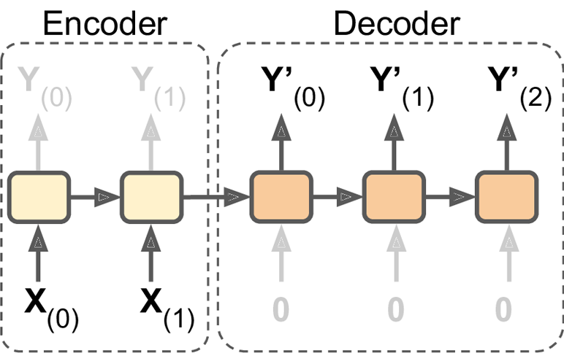
Translation based KGQA model
These models treat semantic parsing as a Machine translation problem
Natural Language to SPARQL or any other Graph Search Language
A sequence-to-sequence model is learned to translate a natural question into a formal query similar to language (machine) translation models

Slide 61
Knowledge graph creation & Reasoning
Challenging for humans to feed in all possible required information – indicate synonyms
Can this task be automated?
Can Information extraction / Named Entity extraction / Relation extraction / Coreference Resolution help in constructing Knowledge Graph automatically?
Can approximate reasoning help in answering queries approximately?

Slide 62
Creating a Knowledge Base from Text Documents
Step 1- Collect reliable text repository
Step 2 - Extract all relation triplets of type <Entity, relation, Entity>
<Noun phrase / NER, Verb_phrase, Noun phrase / NER>
Step 3 - Discover hidden facts and relationships based on patterns and inferences that allow for large scale analysis and identification of related topics and things

Slide 63
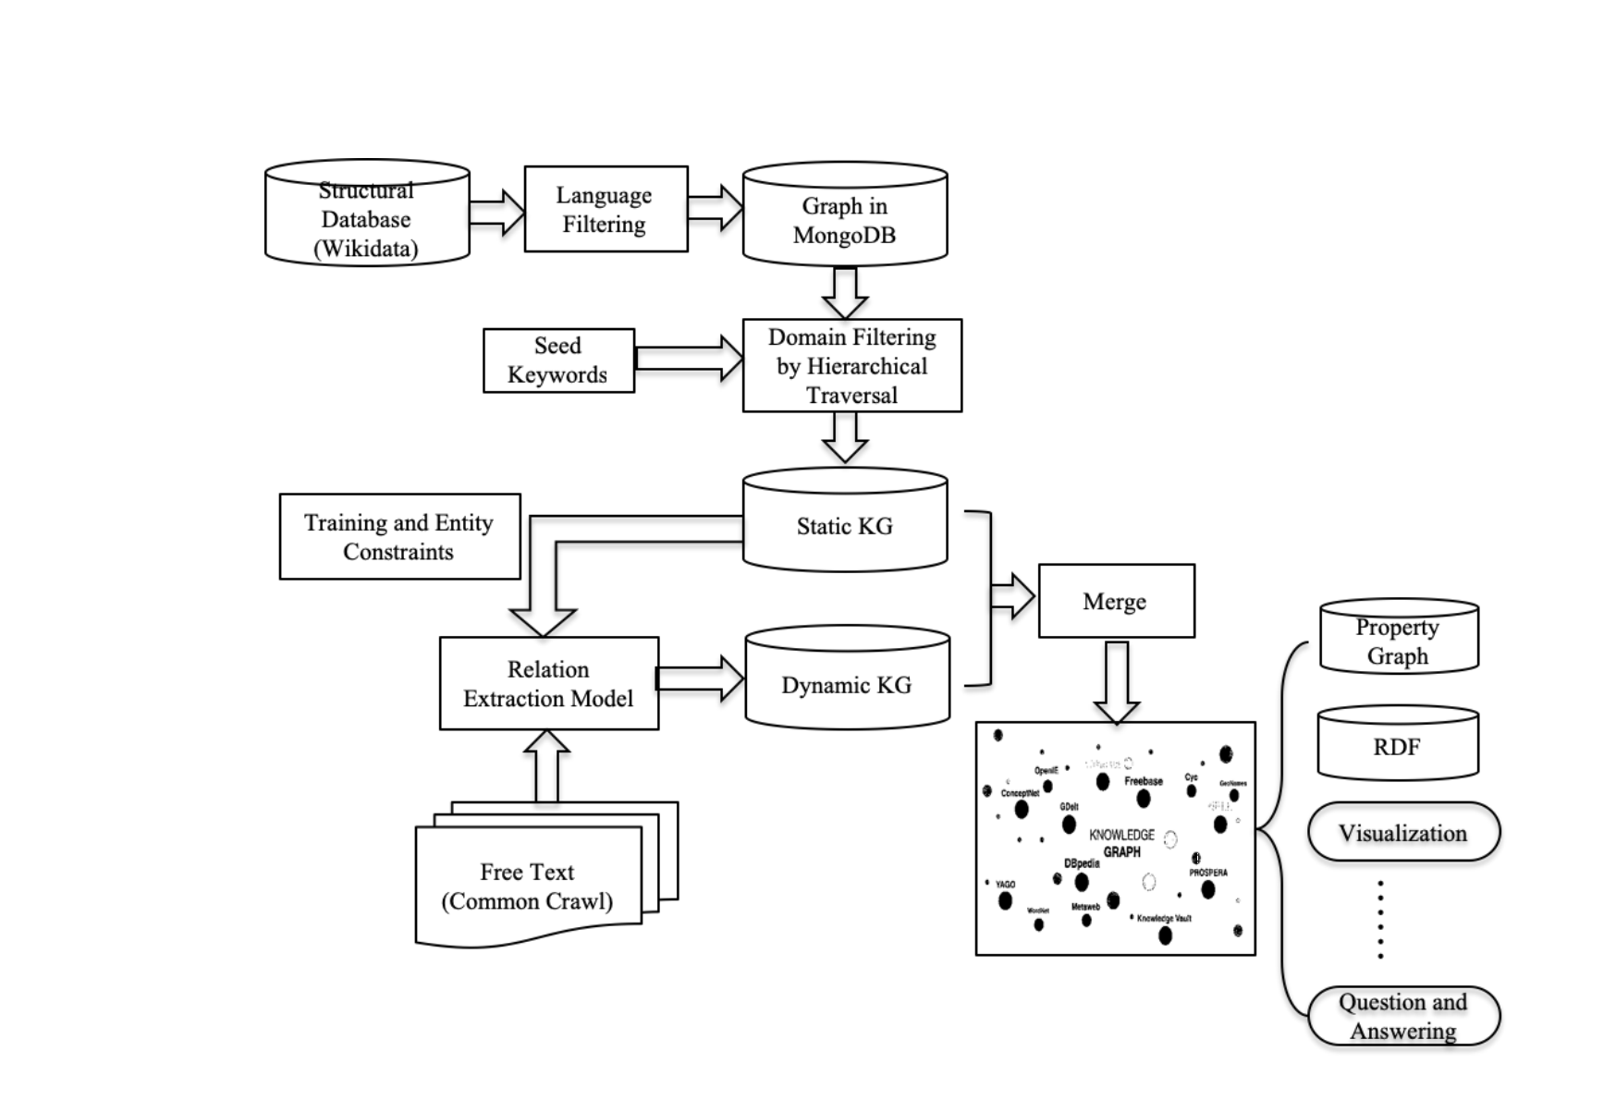
Construction of Domain-Specific Knowledge Graphs

Slide 64
Static KG with Linked Open Data
Choose and existing KG like Wikidata as the initial knowledge database
Based on a set of domain-specific keywords - set up a hierarchical traversal starting from nodes or edges that match the seed keywords
Resulting subject-relation-object triples from this step are used to form a so-called static KG
Can also be used to match sentences from Common Crawl free text to create a large dataset to train a relation extraction model

Slide 65
Relation Extraction
Relation Extraction is the task of predicting attributes and relations for entities in a sentence
Barack Obama was born in Honolulu, Hawaii.
predict each relation - r
(Barack Obama, r1, Honolulu)
(Barack Obama, r2, Hawaii)
(Honolulu, r3, Hawaii)
Ideally - what should be predicted
r1 = was born in
r2 = was born in
r3 = is in

Slide 66
5 approaches
Rule-based RE
Weakly Supervised RE
Supervised RE
Distantly Supervised RE
Unsupervised RE

Slide 67
Rule-based RE
Identified from a large text corpora using hand-crafted patterns
Find triples (X, α, Y) where X, Y are entities and α are words in between
Example - X and Y are entities and α = “is in”
Sentences retrieved - Paris is in France - Delhi is in India etc.
May also retrieve - Deepika Padukone is in Bangalore
X
Tedious but Precise
Can work for very restricted context

Slide 68
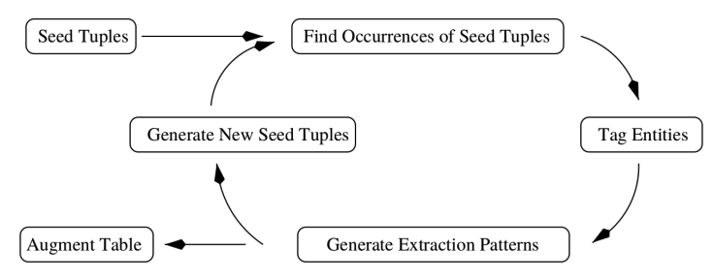
Weakly Supervised Relation extraction
Start out with a set of hand-crafted rules - seed set
Automatically find new ones from the unlabeled text data, through iterative process
E.g. seed={(ORG:IBM, LOC:Armonk), (ORG:Microsoft, LOC:Redmond)} states entities having the relation “based in”
“IBM shut down an office in Hursley” - X
TCS is_located_in DELHI
Google Labs has_office _in Bangalore

Slide 69
Supervised RE
Train a binary classifier to determine if there is a specific relation between two entities
These classifiers can take features about the text as input
Works better if \ annotated by other NLP modules first
Typical features are:
context words,
part-of-speech tags,
dependency path between entities,
NER tags, tokens,
proximity distance between words

Slide 70
Supervision
1st way - Manually label the text data i.e. a sentence is relevant or not for a specific relation type.
E.g. for the “CEO” relation: - “Apple CEO Steve Jobs said to Bill Gates.” is relevant “Bob, Pie Enthusiast, said to Bill Gates.” is not relevant (doesn’t have CEO)
2nd way - Manually label the relevant sentences as positive/negative if they are expressing the relation. E.g. “Apple CEO Steve Jobs said to Bill Gates.”: (Steve Jobs, CEO, Apple) is positive (Bill Gates, CEO, Apple) is negative
Learn a binary classifier to determine if the sentence is relevant for the relation type
Use the classifiers to detect relations in new text data.
Use the classifiers to detect relations in new text data.
Expensive to label examples
Expensive/difficult to add new relations - needs retraining

Slide 71
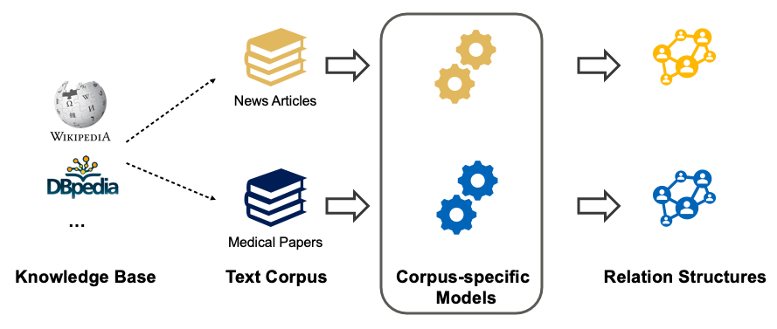
Distant Supervision
Combining Seed-set rules and Supervision - with seed set picked up from an existing KG - Wikipedia, DBpedia, Wikidata, Freebase, Yago.
For each relation type of interest in the KB
For each tuple of this relation in the KB
Select sentences from unlabeled text data that match these tuples (both words of the tuple is co-occurring in the sentence), and assume that these sentences are positive examples for this relation type
Extract features from these sentences (e.g. POS, context words, etc)
Train a supervised classifier on this
Less manual effort - but NOISY
Careful validation before use

Slide 72
Unsupervised RE
Extract relations from text without having to label any training data, provide a set of seed tuples or having to write specific rules to capture different types of relations in the text
Rely on a set of very general constraints and heuristics - “rules” are at a more general level
These systems tend to require less supervision in general.

Slide 73
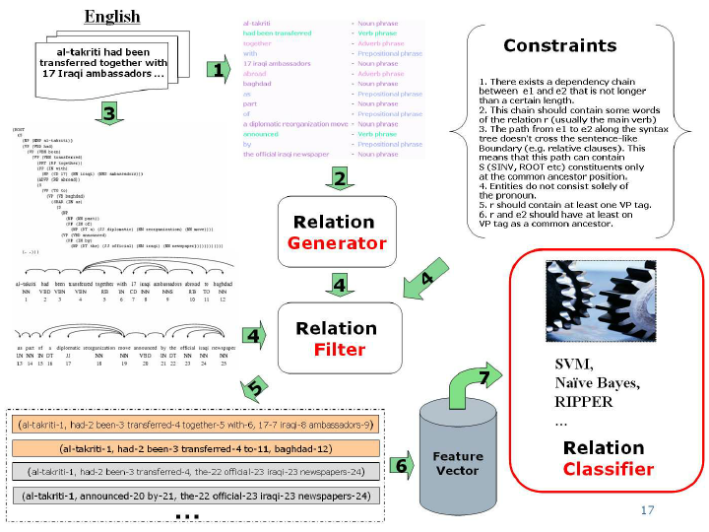
Unsupervised RE
Statistical validation of relation

Slide 74
TextRunner RE algorithm
Step 1 - Train a self-supervised classifier on a small corpus
For each parsed sentence, find all pairs of noun phrases (X, Y) with a sequence of words r connecting them. Label them as positive examples if they meet all of the constraints, otherwise label them as negative examples.
Map each triple (X, r, Y) to a feature vector representation (e.g. incorporating POS tags, number of stop words in r, NER tag, etc.)
Train a binary classifier to identify trustworthy candidates

Slide 75
TextRunner RE algorithm
Step 2 - Pass over the entire corpus and extract possible relations
Fetch potential relations from the corpus
Keep/discard candidates according to if the classifier considers them as trustworthy or not

Slide 76
TextRunner RE algorithm
Step 3 . Rank-based assessment of relations based on text redundancy
Normalize (omit non-essential modifiers) and merge relations that are same
Count the number of distinct sentences the relations are present in and assign probabilities to each relation
https://medium.com/@andreasherman/different-ways-of-doing-relation-extraction-from-text-7362b4c3169e

Slide 77
Open IE - relation extraction
Open Information Extraction (Open IE) system - Runs over sentences and creates extractions that represent relations in text - (Subj, Predicate / relation, Object)
The U.S. president Barack Obama gave his speech on Tuesday and Wednesday to thousands of people
(Barack Obama, is the president of, United States)
(Barack Obama, gave, his speech)
(Barack Obama, gave his speech, on Tuesday)
(Barack Obama, gave his speech, on Wednesday)
(Barack Obama, gave his speech, to thousands of people)
http://openie.cs.washington.edu/.

Slide 78
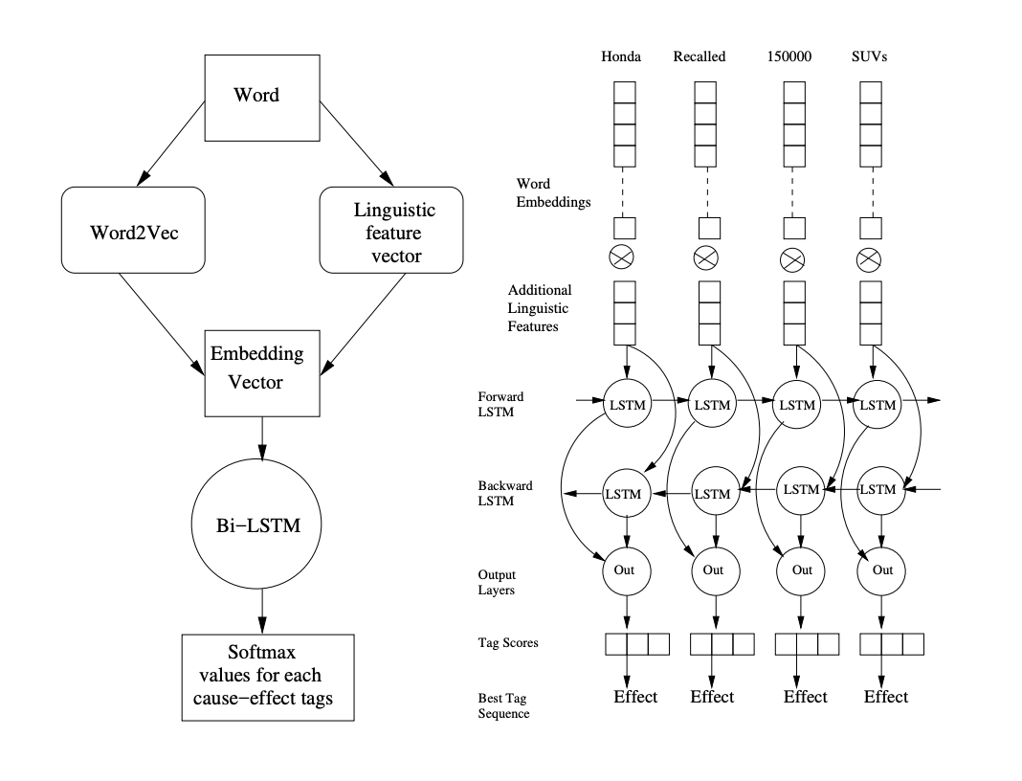
Learning causal relations
Cause - effect relationships between incidents
The car refused to start since its fuel tank was empty
Aircel files for bankruptcy ove mounting financial trouble

Slide 79
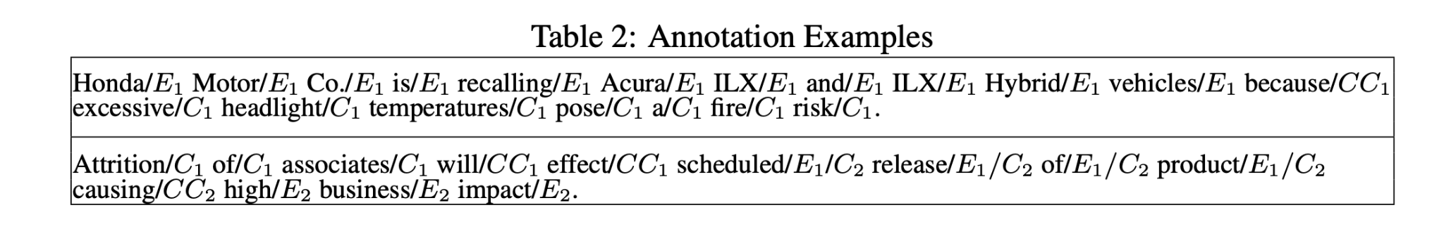
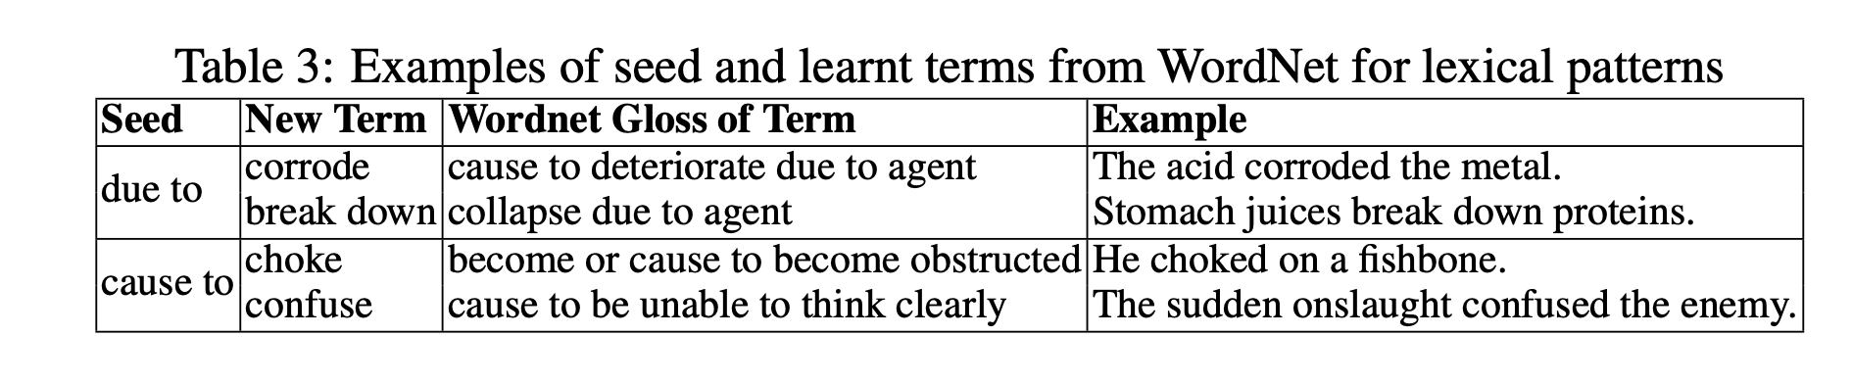
Sequence Labeling Problem

Slide 80
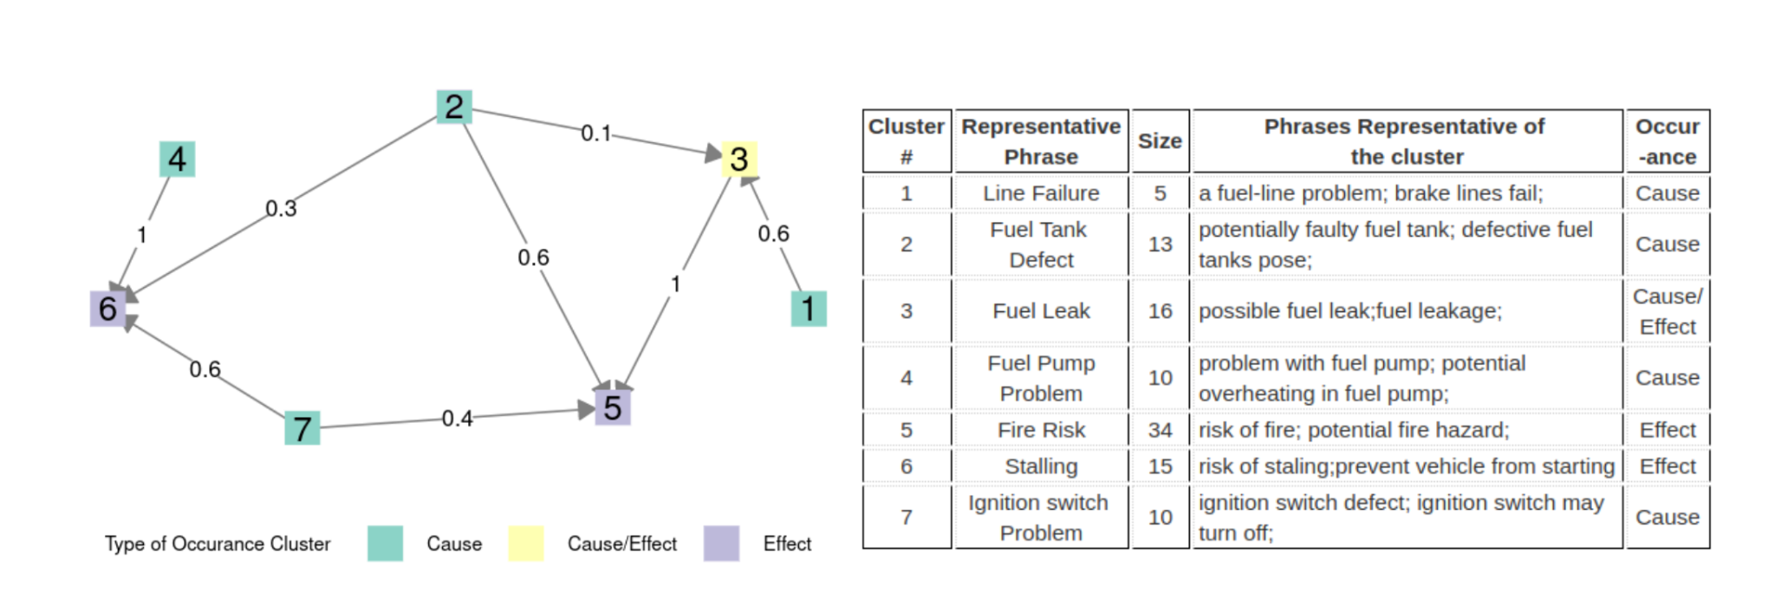
Building causal graph
Clustering of similar phrases

Slide 81
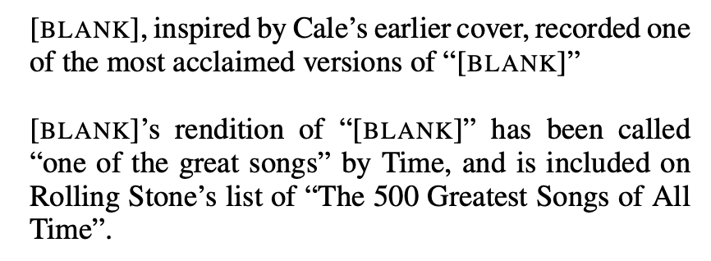
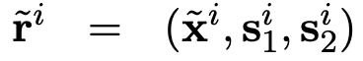
Relation Learning using BERT
x is the tokenized sentence, with s1 and s2 being the spans of the two entities within that sentence
The two relation statements r1 and r2 contain the same entity pair - which have been replaced with the “[BLANK]” symbol
Intuition is that if both r1 and r2 contain the same entity pair (s1 and s2), they should have the same s1-s2 relation
Reference - Livio Baldini Soares, Nicholas FitzGerald, Jeffrey Ling and Tom Kwiatkowski, Matching the Blanks: Distributional Similarity for Relation Learning (https://arxiv.org/pdf/1906.03158.pdf) (2019)

Slide 82
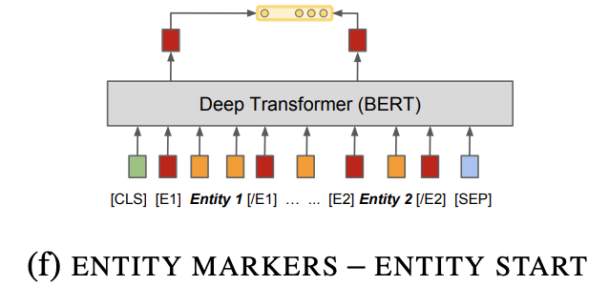
Pre-training BERT to encode relations
Standard BERT architecture is used with slight modifications to encode the input relation statements and to extract their pre-trained output representations for loss calculation & downstream fine-tuning tasks
The output hidden states of BERT at the “[E1]” and “[E2]” token positions are concatenated as the final output representation of x, which is then used along with that from other relation statements for loss calculation, such that the output representations of two relation statements with the same entity pair should have a high inner product

Slide 83
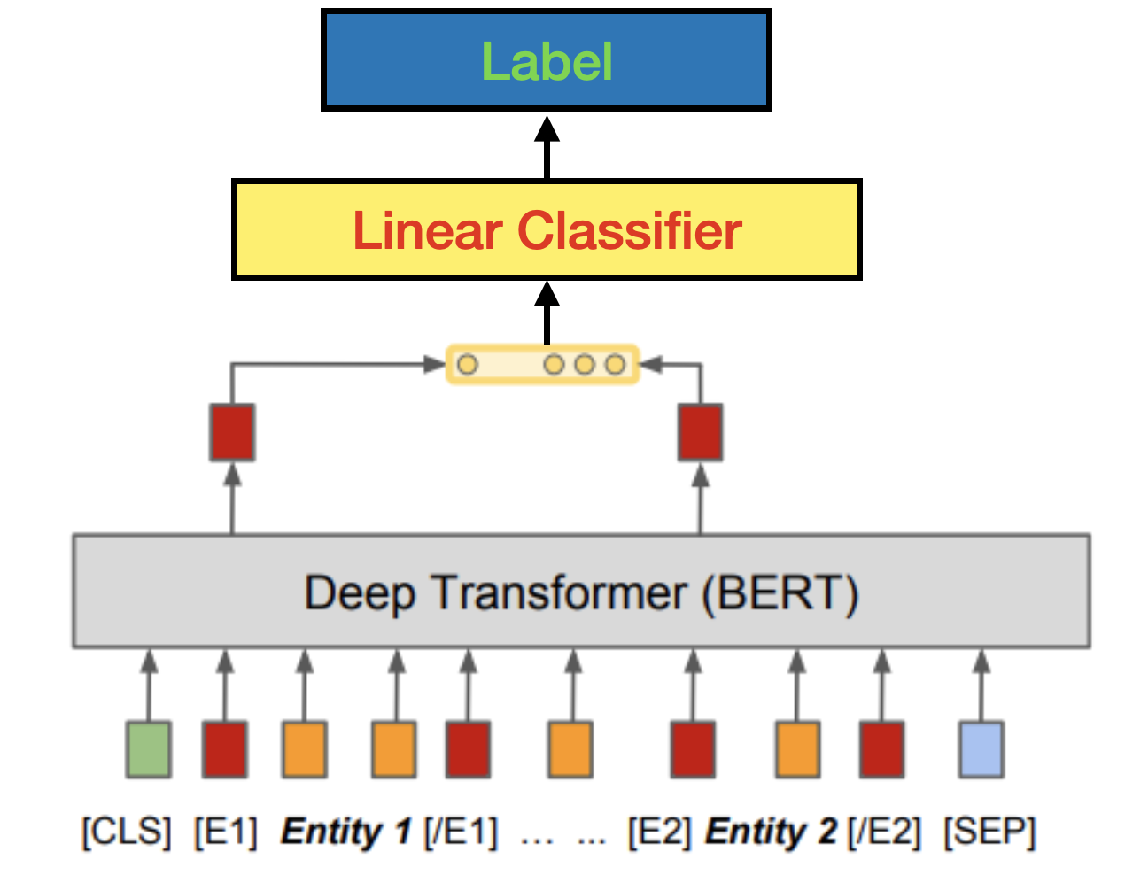
Learning relations as Class Labels
Relation Types to be learnt - Class Labels
Cause-Effect - L1
Entity-Location - L2
Person - Interest - L3

Slide 84
To Summarize
Knowledge Graphs store knowledge in a graph
Nodes represent entities - Relations stored in Edges - relations have semantic interpretation
Question Answering - retrieving the right sub-graph
involves NL interpretation and transformation / translation
Creating KGs automatically
Need NLP for text documents
Relation extraction and classification
R
E2
E1
E1
E2
E2

